Slide 1
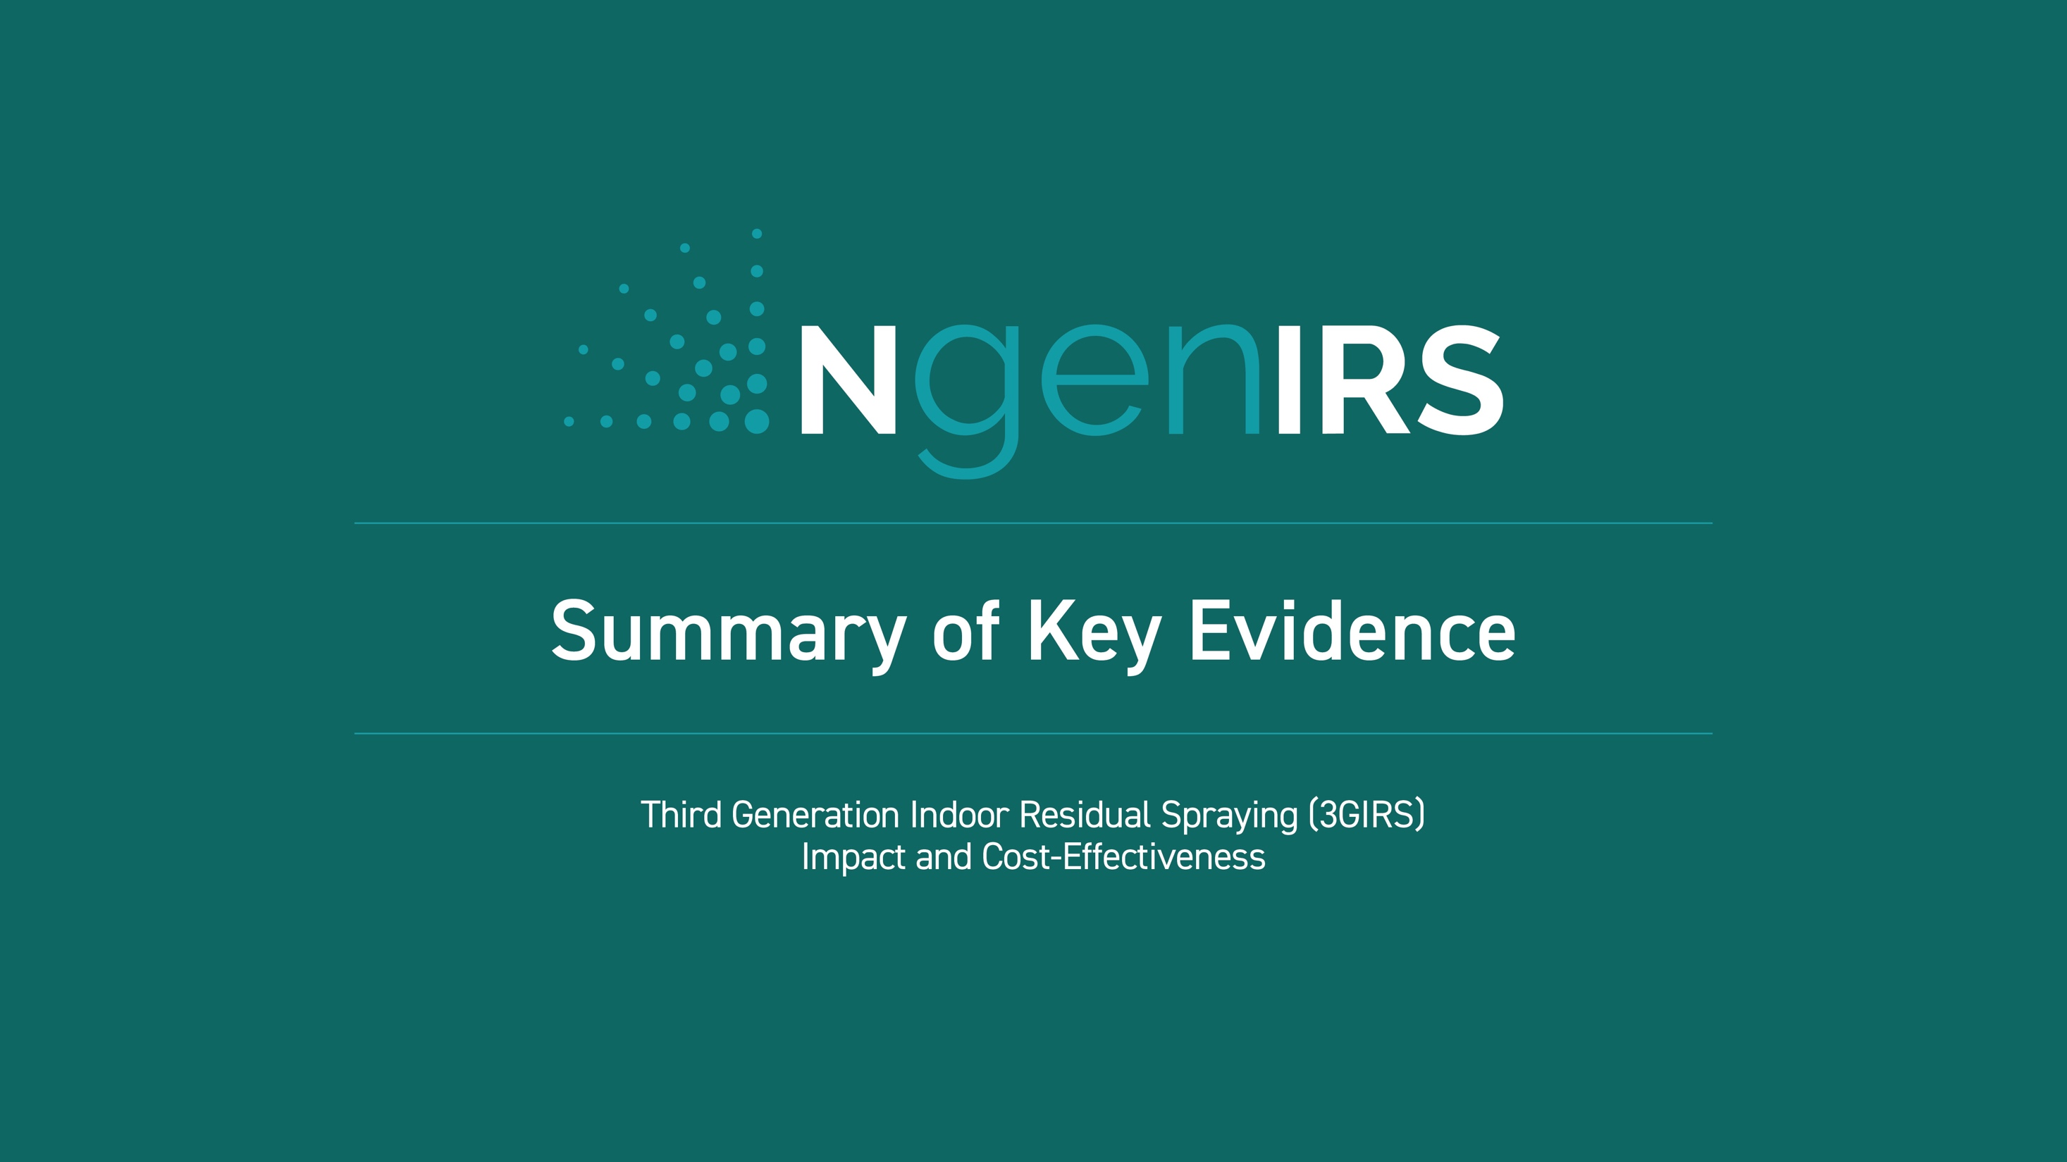

Slide 2
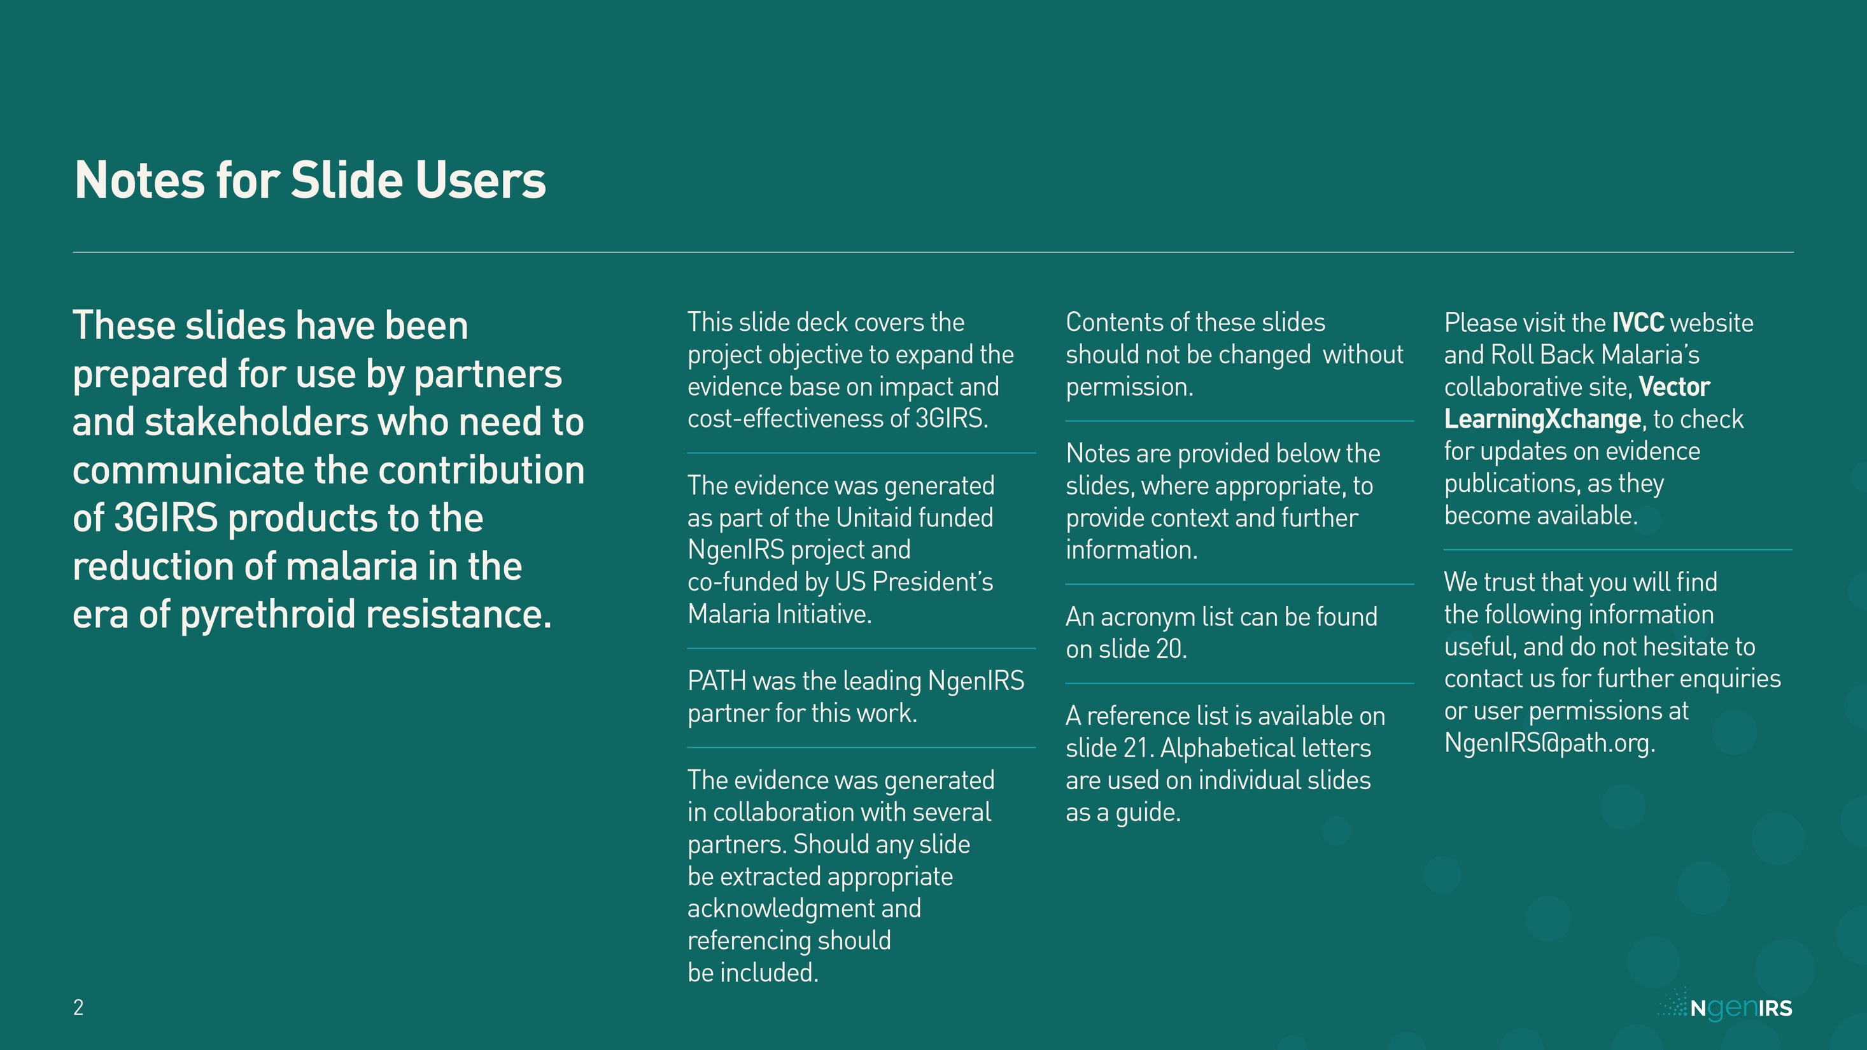

Slide 3
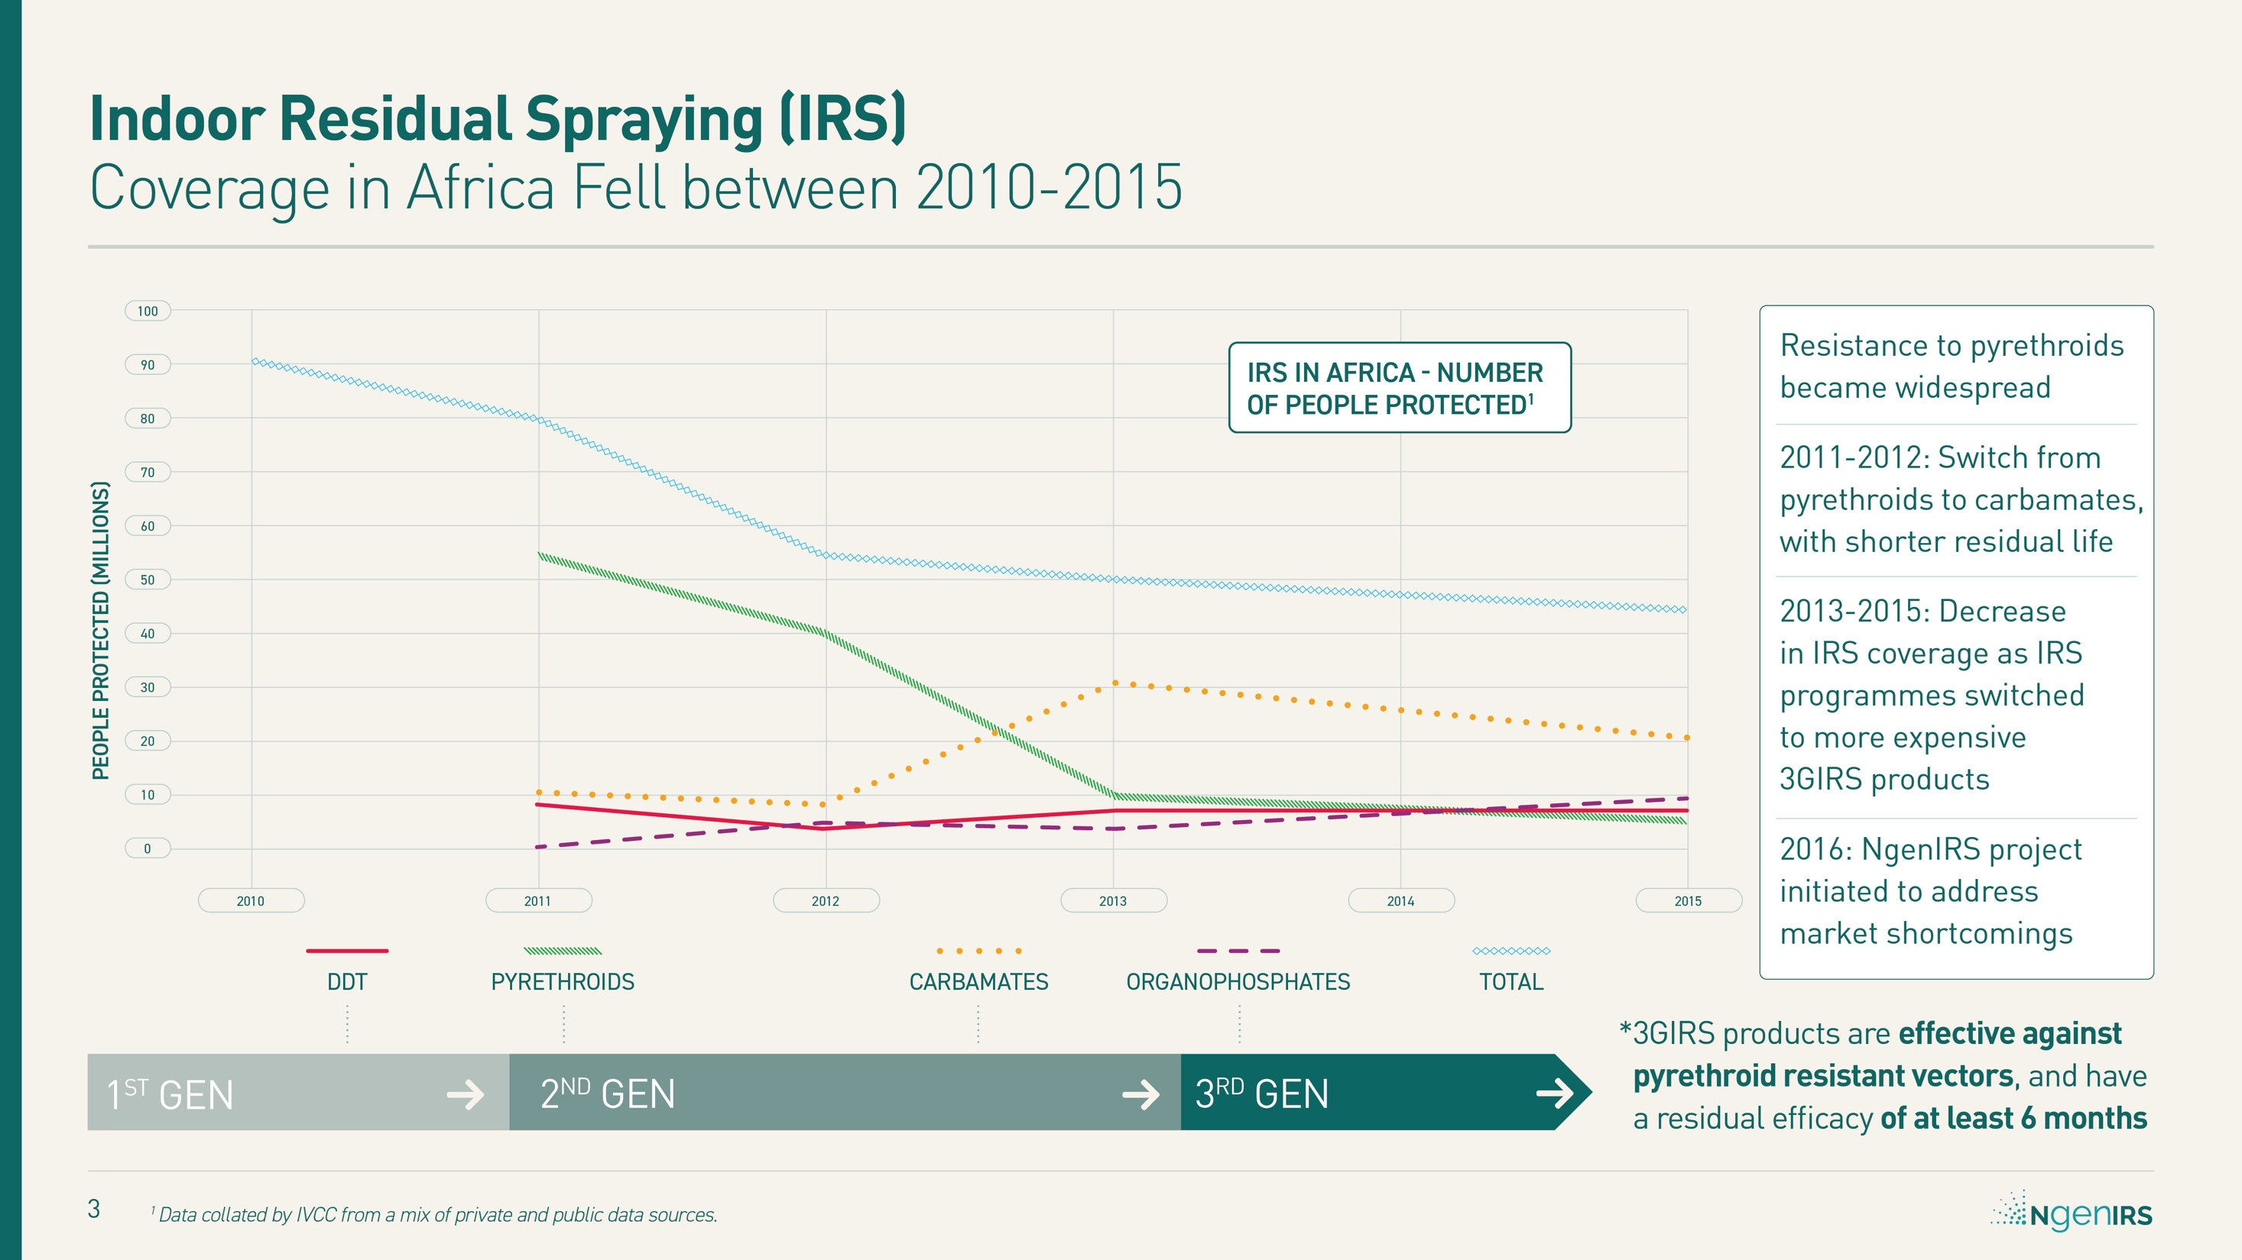
Notes:
What exactly is a 3GIRS product?
DDT was the most widely used of the first-generation IRS products. Pyrethroids represented the 2nd generation, and resistance has driven the need to develop the next generation of products, effective against pyrethroid resistant vectors, with a residual efficacy of at least 6 months. Initially, 3GIRS products were substantially more expensive – which contributed to falling coverage.
3GIRS - Third generation IRS product effective against pyrethroid resistant vectors, with a residual efficacy of at least 6 months
DDT – Dichlorodiphenyltrichloroethane
IRS – Indoor Residual Spraying

Slide 4
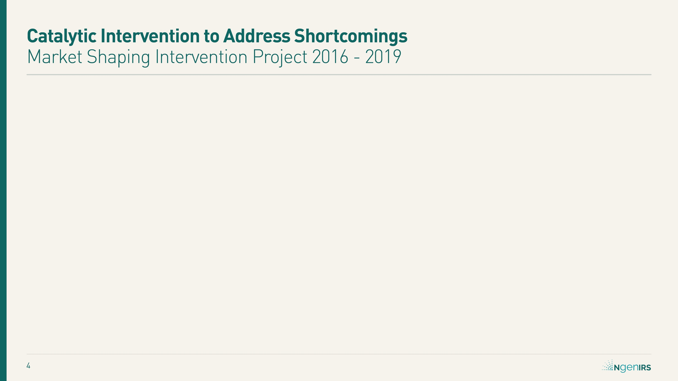
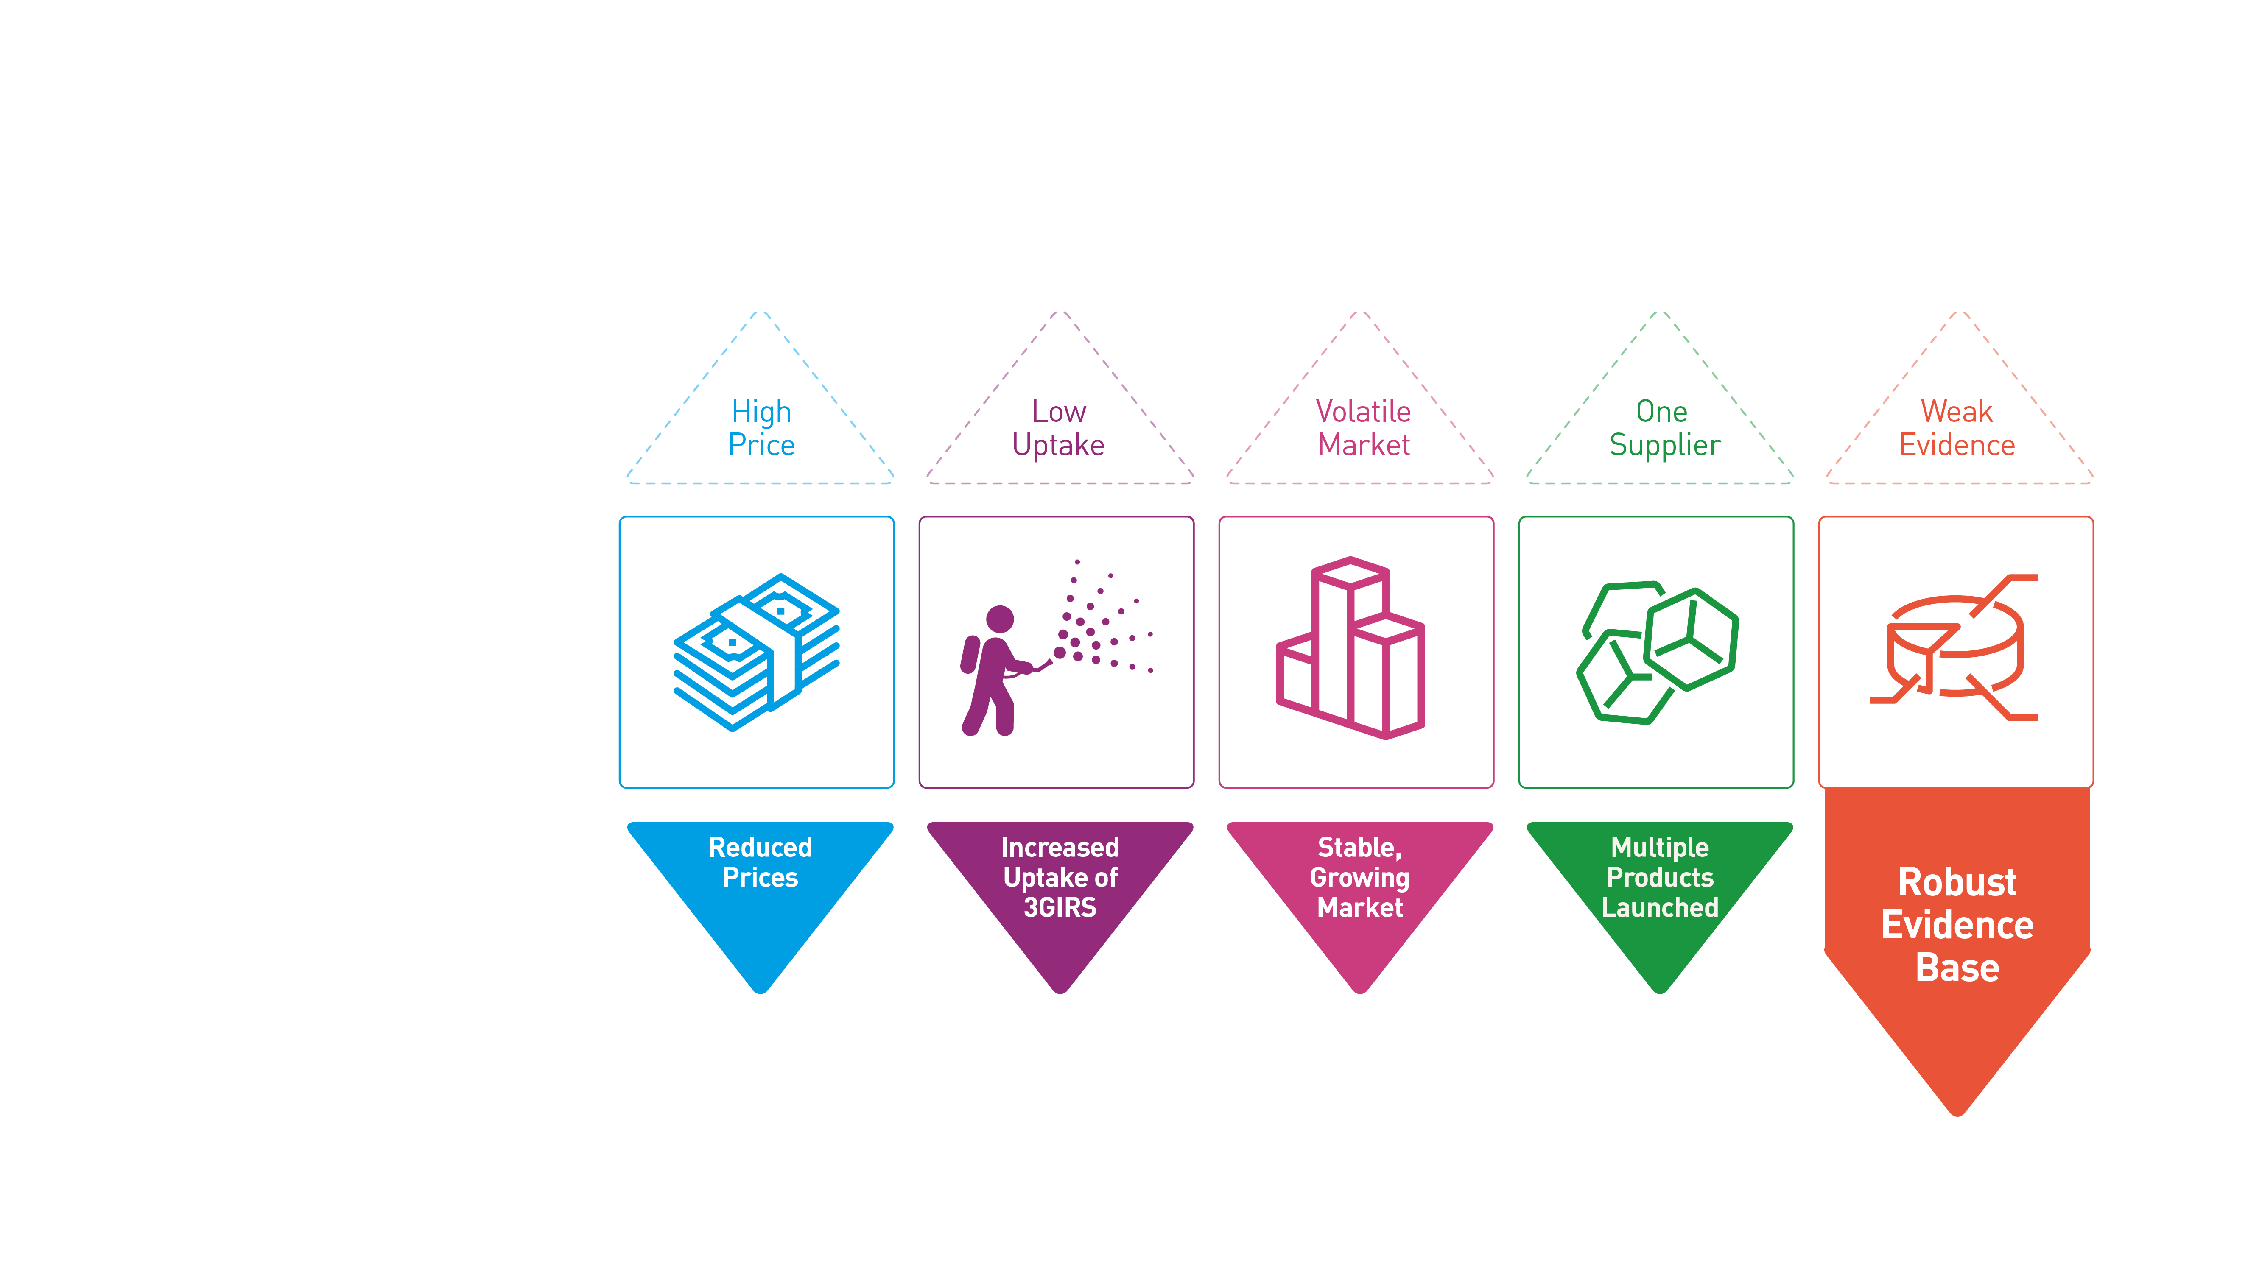
Notes:
The 4 year (2016 – 2019), Unitaid-funded NgenIRS project was a partnership, led by IVCC, that included the US President’s Malaria Initiative, the Global Fund, Abt Associates and PATH. NgenIRS worked in close collaboration with leading insecticide manufacturers, national malaria programs, and other stakeholders to protect health and save lives by reducing transmission of malaria through affordable Indoor Residual Spraying (IRS) of long-lasting, non-pyrethroid insecticides.

Slide 5
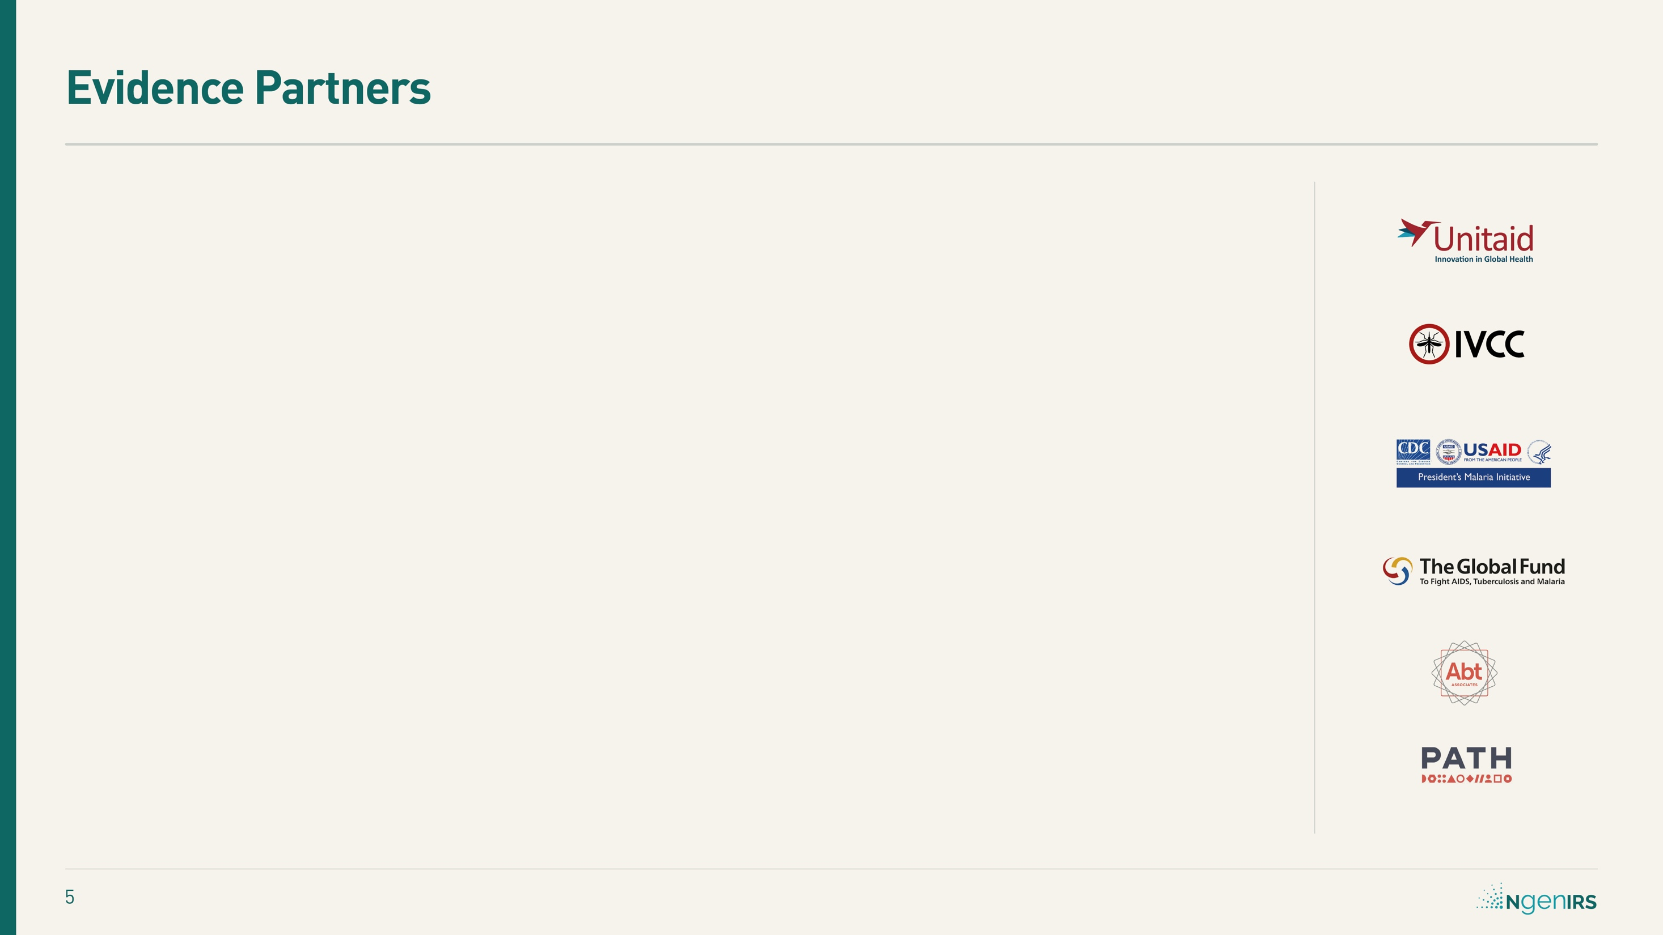
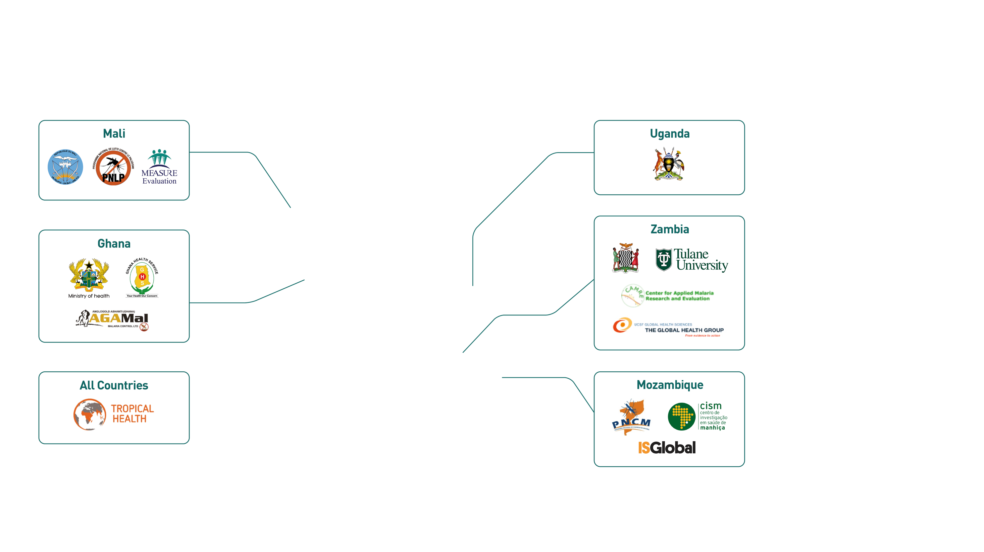
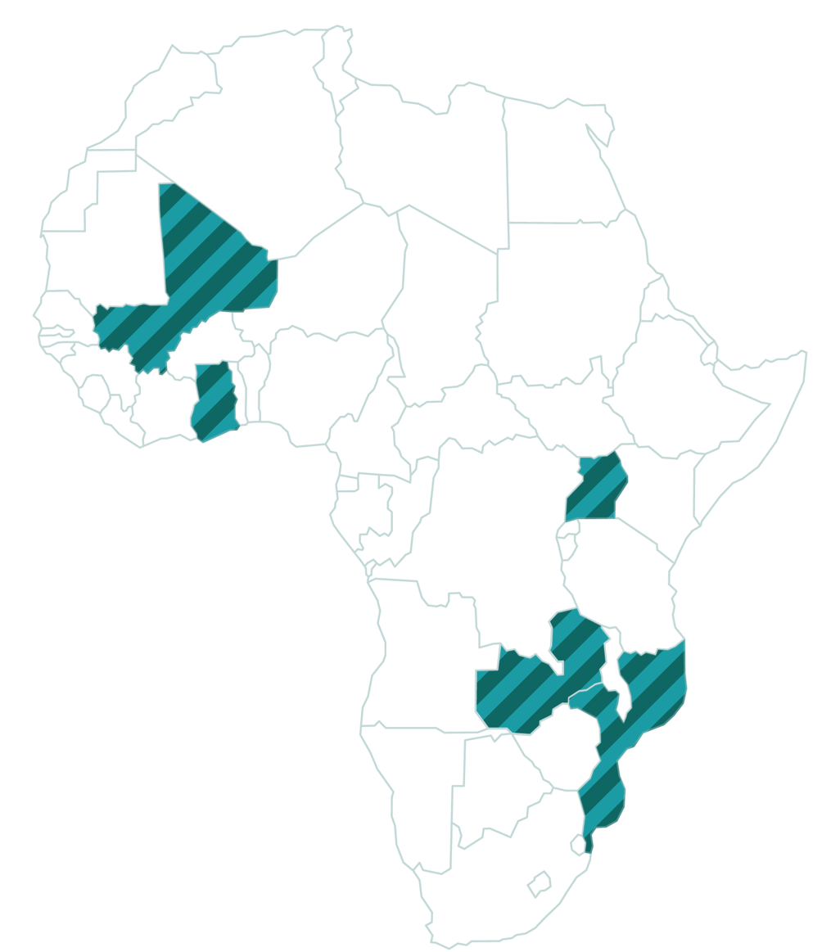
Notes:
It is important to acknowledge all the project partners who each played a critical role in the work presented. NgenIRS was a large, complex project and it could not have accomplished as much without a vast roster of dedicated partners in each partner country.

Slide 6
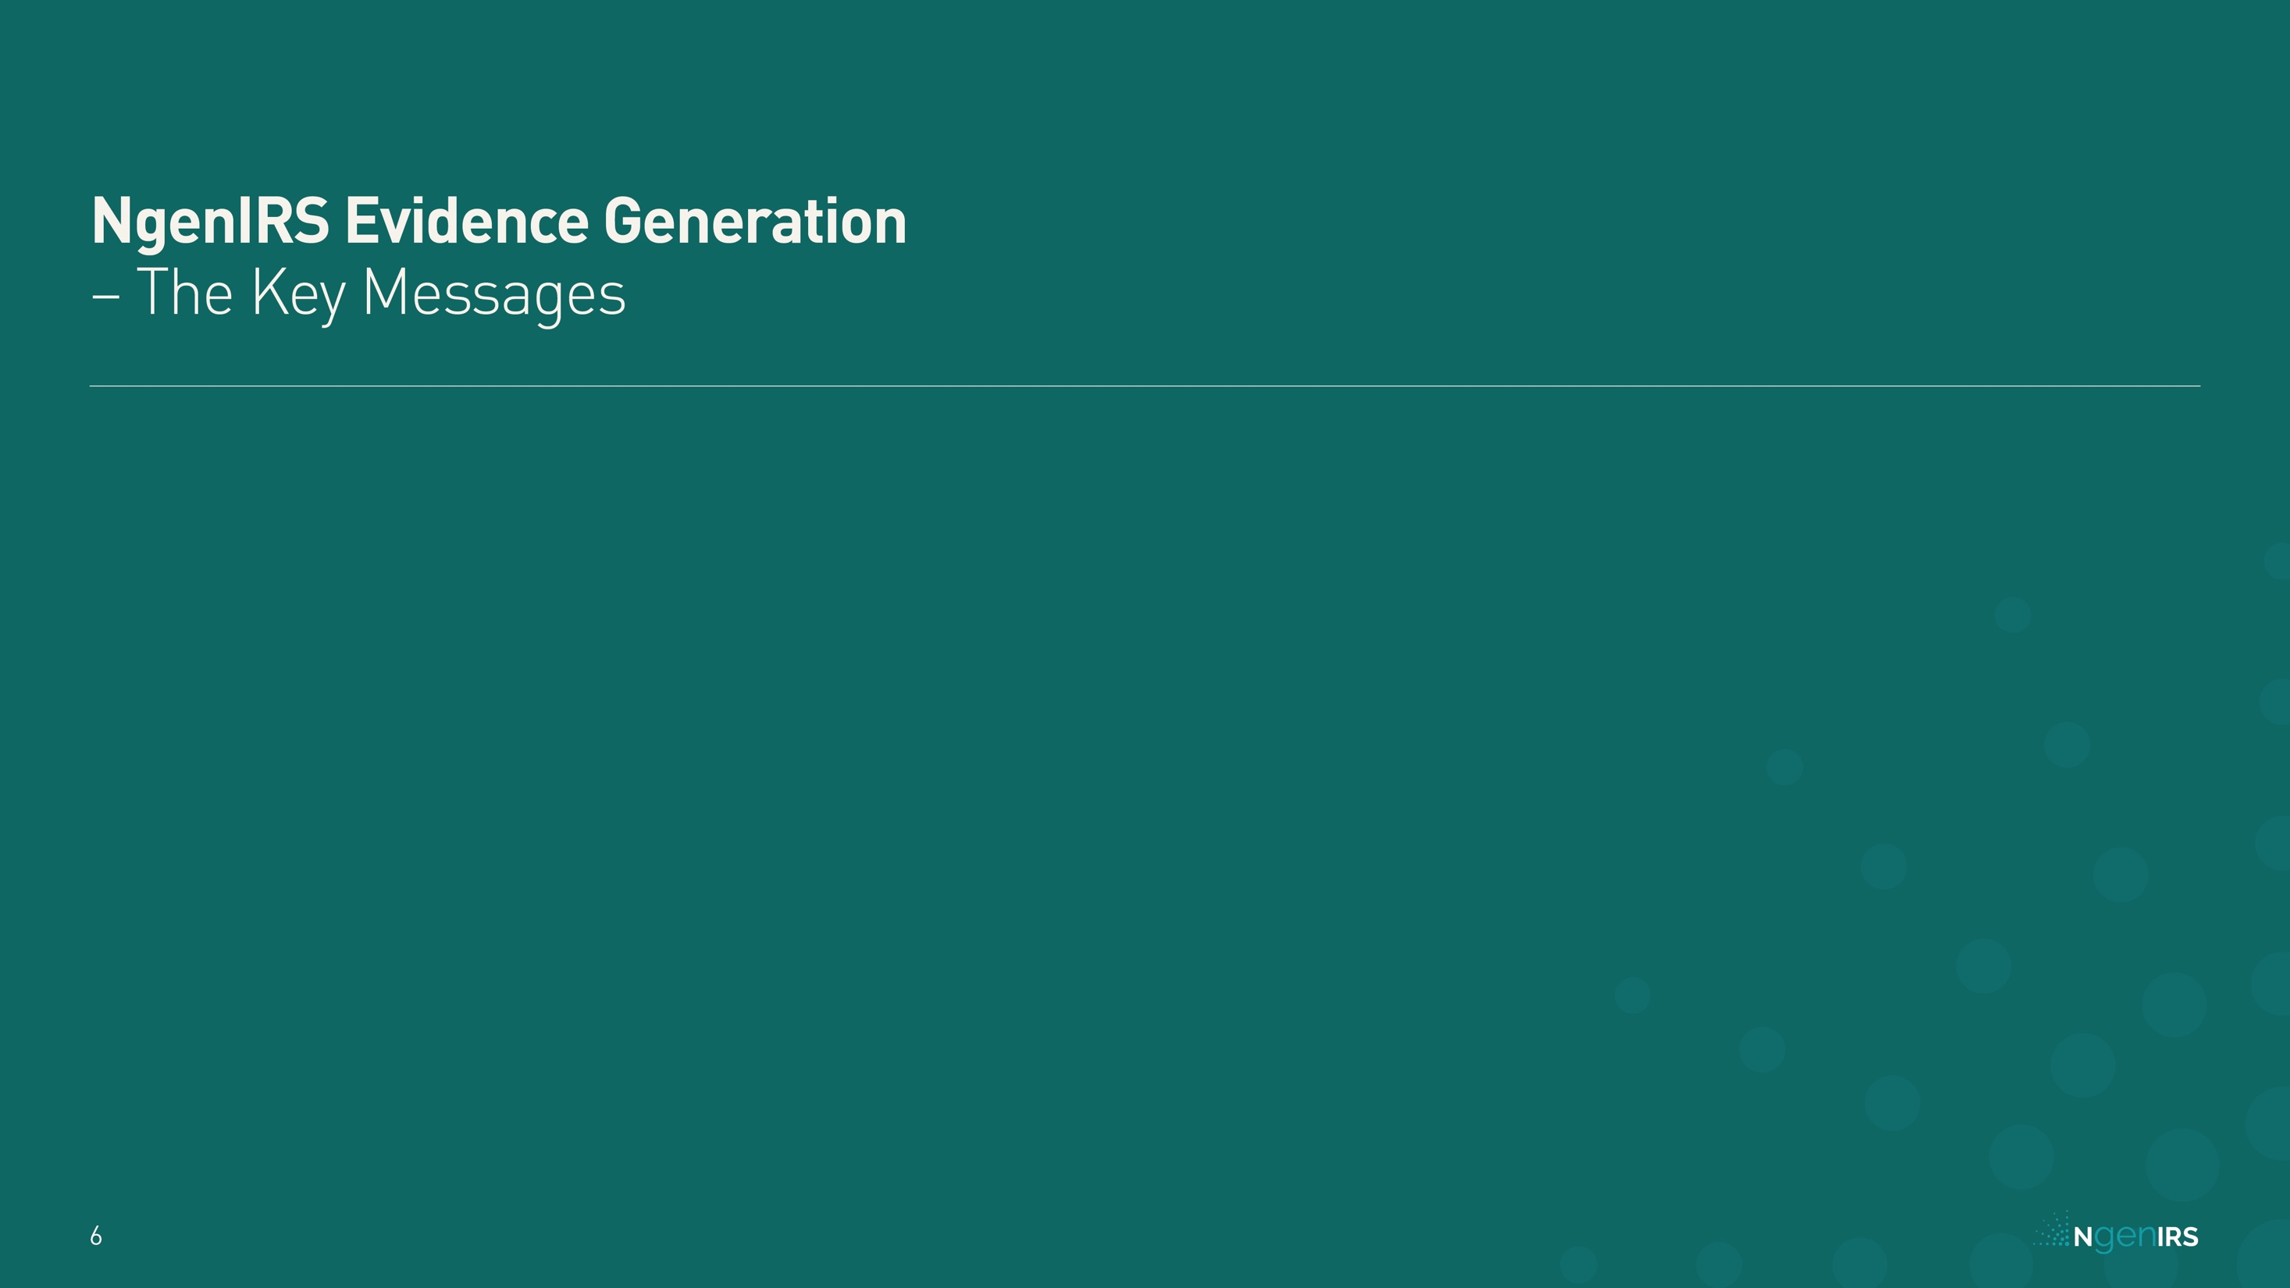
Notes:
3GIRS - Third generation IRS product effective against pyrethroid resistant vectors, with a residual efficacy of at least 6 months
IRS – Indoor Residual Spraying
LLIN - Long Lasting Insecticidal Nets

Slide 7
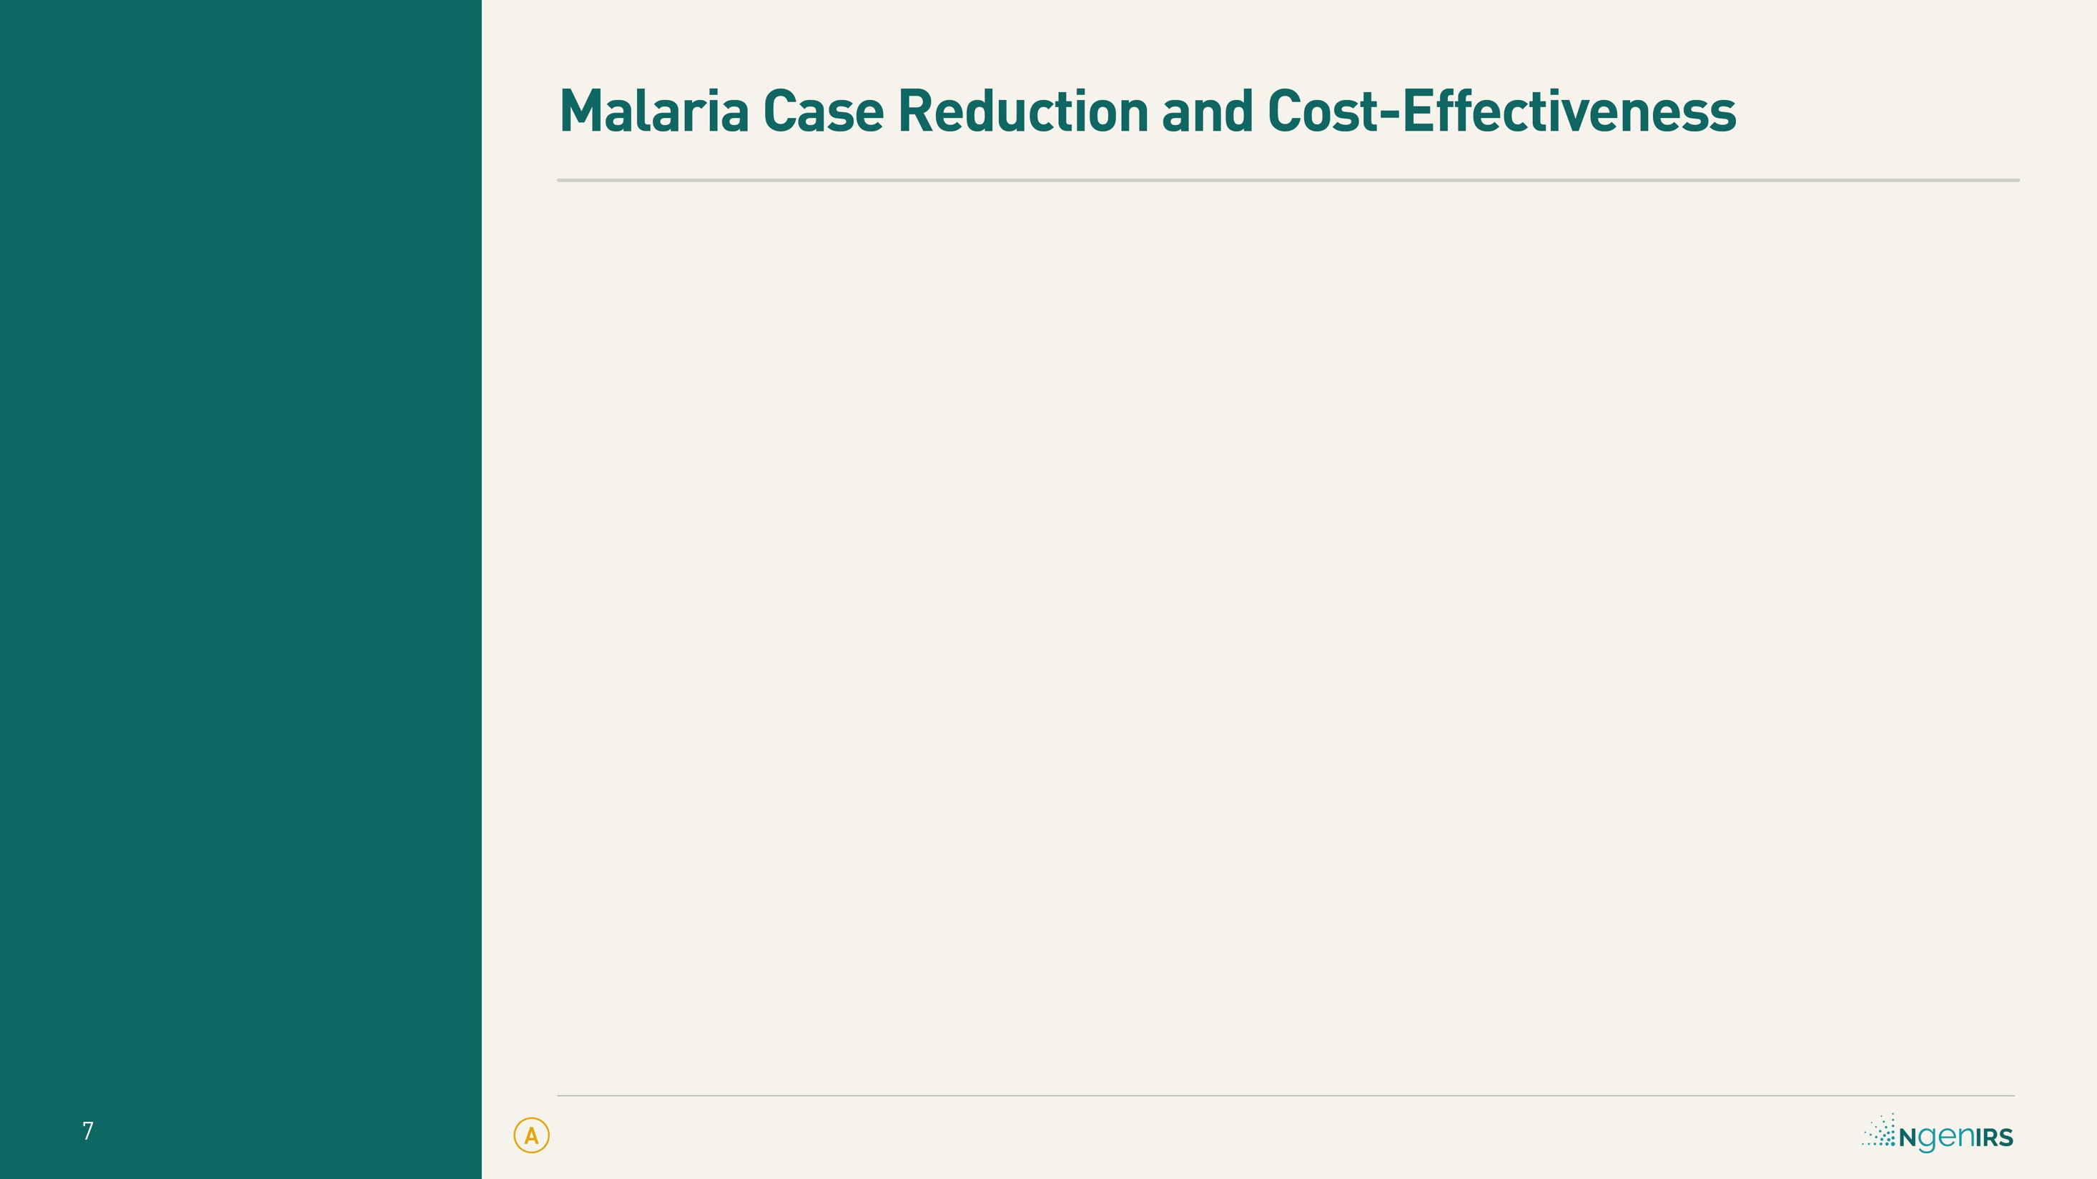

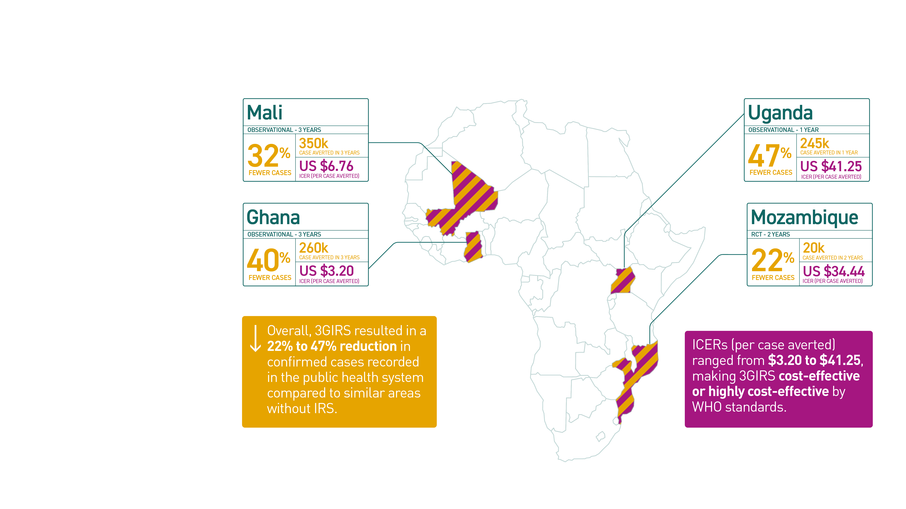
Notes:
All numbers come from comparisons of all age malaria cases reported by health facilities in areas where Actellic®300 CS was used compared to neighbouring districts without IRS.
Levels of LLIN coverage included:
Mali: Ownership = 85 – 90%; Use = 67 – 78%
Ghana: Ownership > 80%; Use = 50 – 60%
Mozambique: Ownership 50 - 90%; Use = 50 - 90% (in year 2 of the trial, after a universal distribution campaign in 2017)
Uganda: Ownership = 90%; Use = 74%
LLIN coverage estimates come from the appropriate Demographic and Health Survey and/or Malaria Indicator Survey results, except for the Mozambique estimates which come directly from the NgenIRS randomised trial results.
Levels of pyrethroid resistance ranged from resistant to highly resistant:
Mali: An. gambiae (6% to 90% mortality – WHO tube tests)
Ghana: An. gambiae (0% to 80% mortality – WHO tube tests)
Mozambique: An. funestus (7 – 86% mortality – WHO tube tests)
Uganda: An. gambiae (0% to 80% mortality – WHO tube tests)
All numbers are for Actellic® 300CS in addition to standard (pyrethroid only) LLINs
3GIRS - Third generation IRS product effective against pyrethroid resistant vectors, with a residual efficacy of at least 6 months
ICER - Incremental Cost-Effectiveness Ratio
IRS – Indoor Residual Spraying
LLIN - Long Lasting Insecticidal Nets
RCT – Randomised Controlled Trial
WHO – World Health Organization

Slide 8
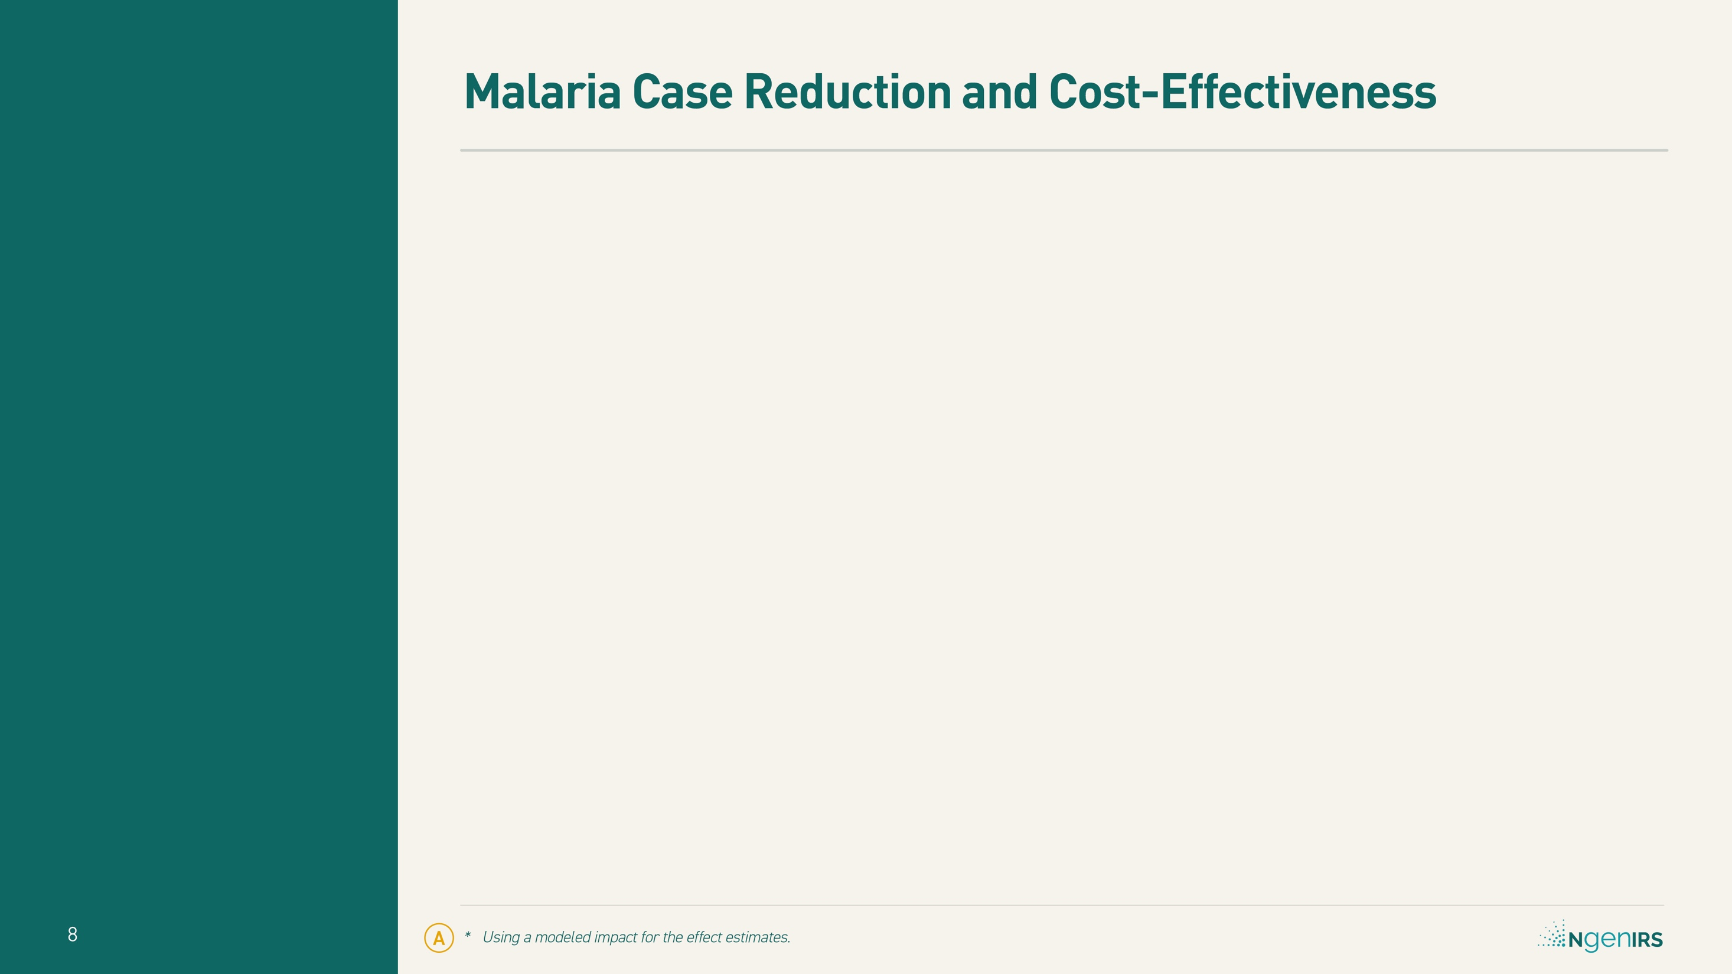

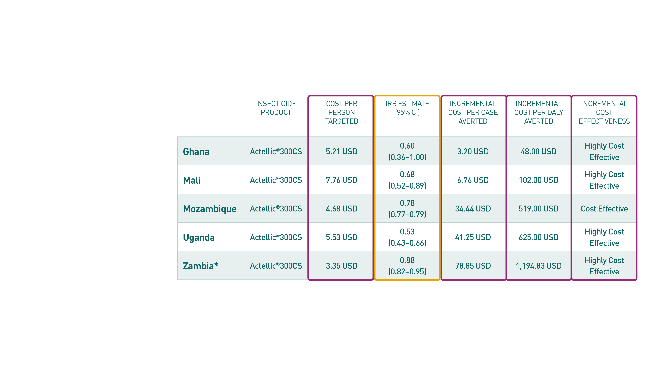
Notes:
The descriptive terms for ICER come from the WHO standards, which compare the Incremental Cost per DALY averted to the nations GDP (IC < 3xGDP = cost-effective; IC < 1xGDP = very cost-effective)
Besides cost, other main drivers of cost-effectiveness include underlying malaria burden and case fatality rates
DALY - Disability-Adjusted Life Year
CI – Confidence Interval
GDP – Gross Domestic Product
IC – Incremental Cost
ICER - Incremental Cost-Effectiveness Ratio
IRR - Incidence Rate Ratio
IRS – Indoor Residual Spraying
LLIN - Long Lasting Insecticidal Nets
WHO – World Health Organization
IRR - Incidence Rate Ratio
USD - US Dollar

Slide 9
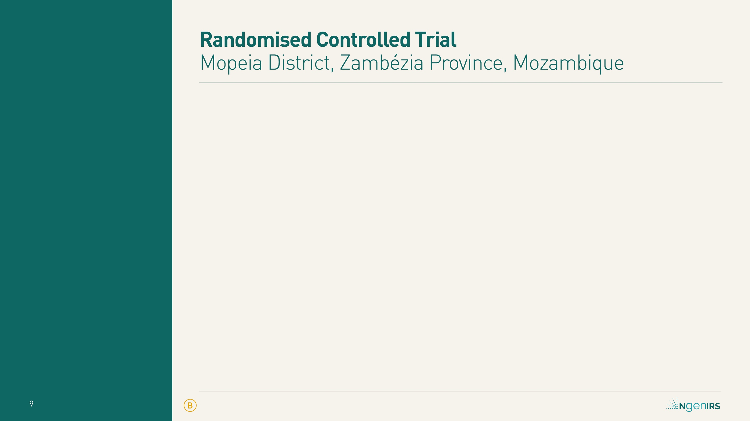

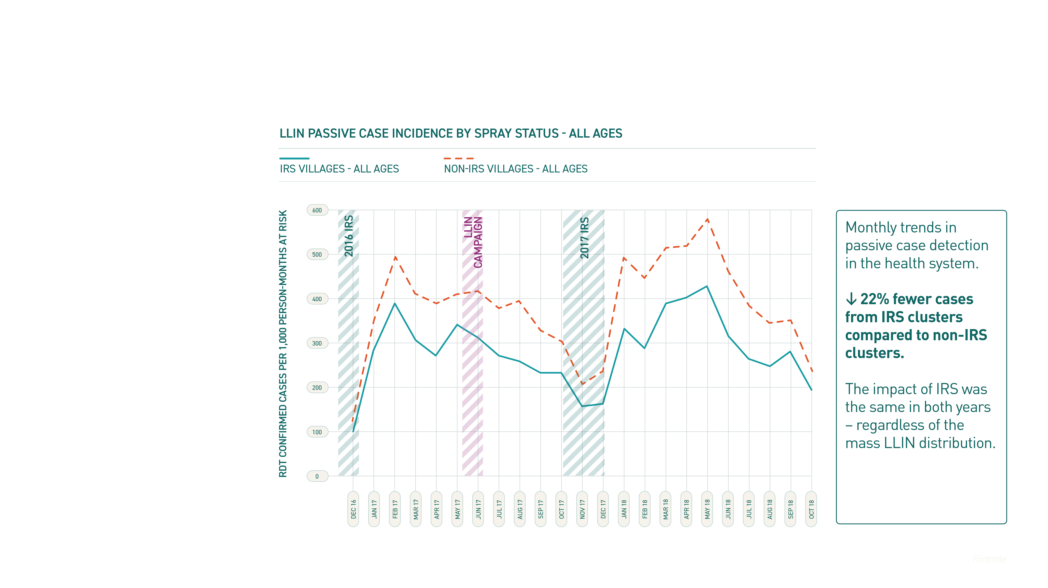
Notes:
An enumeration exercise conducted during June and July of 2016 identified 139,286 total residents across 194 villages. Identified villages were delineated into clusters and stratified by size (combining some villages in close proximity with the same spray status), resulting in 168 clusters that were randomised 1:1 into either the IRS or non-IRS study arm. In the non-IRS study arm, clusters received standard LLINs; in the IRS study arm, clusters received IRS with a microencapsulated formulation of pirimiphos-methyl (Actellic® 300CS) in addition to standard LLINs.
3GIRS - Third generation IRS product effective against pyrethroid resistant vectors, with a residual efficacy of at least 6 months
IRS – Indoor Residual Spraying
LLIN - Long Lasting Insecticidal Nets
RCT – Randomised Controlled Trial

Slide 10
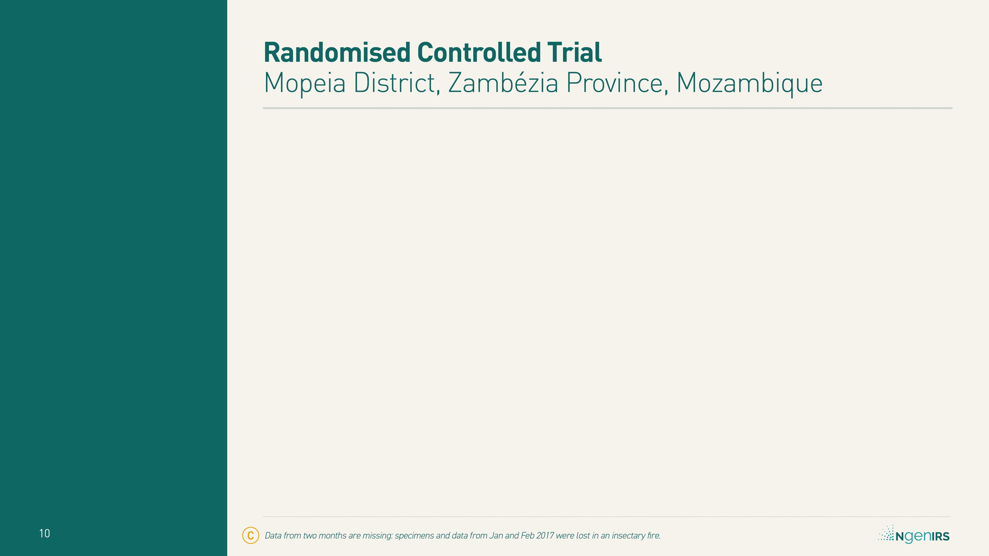

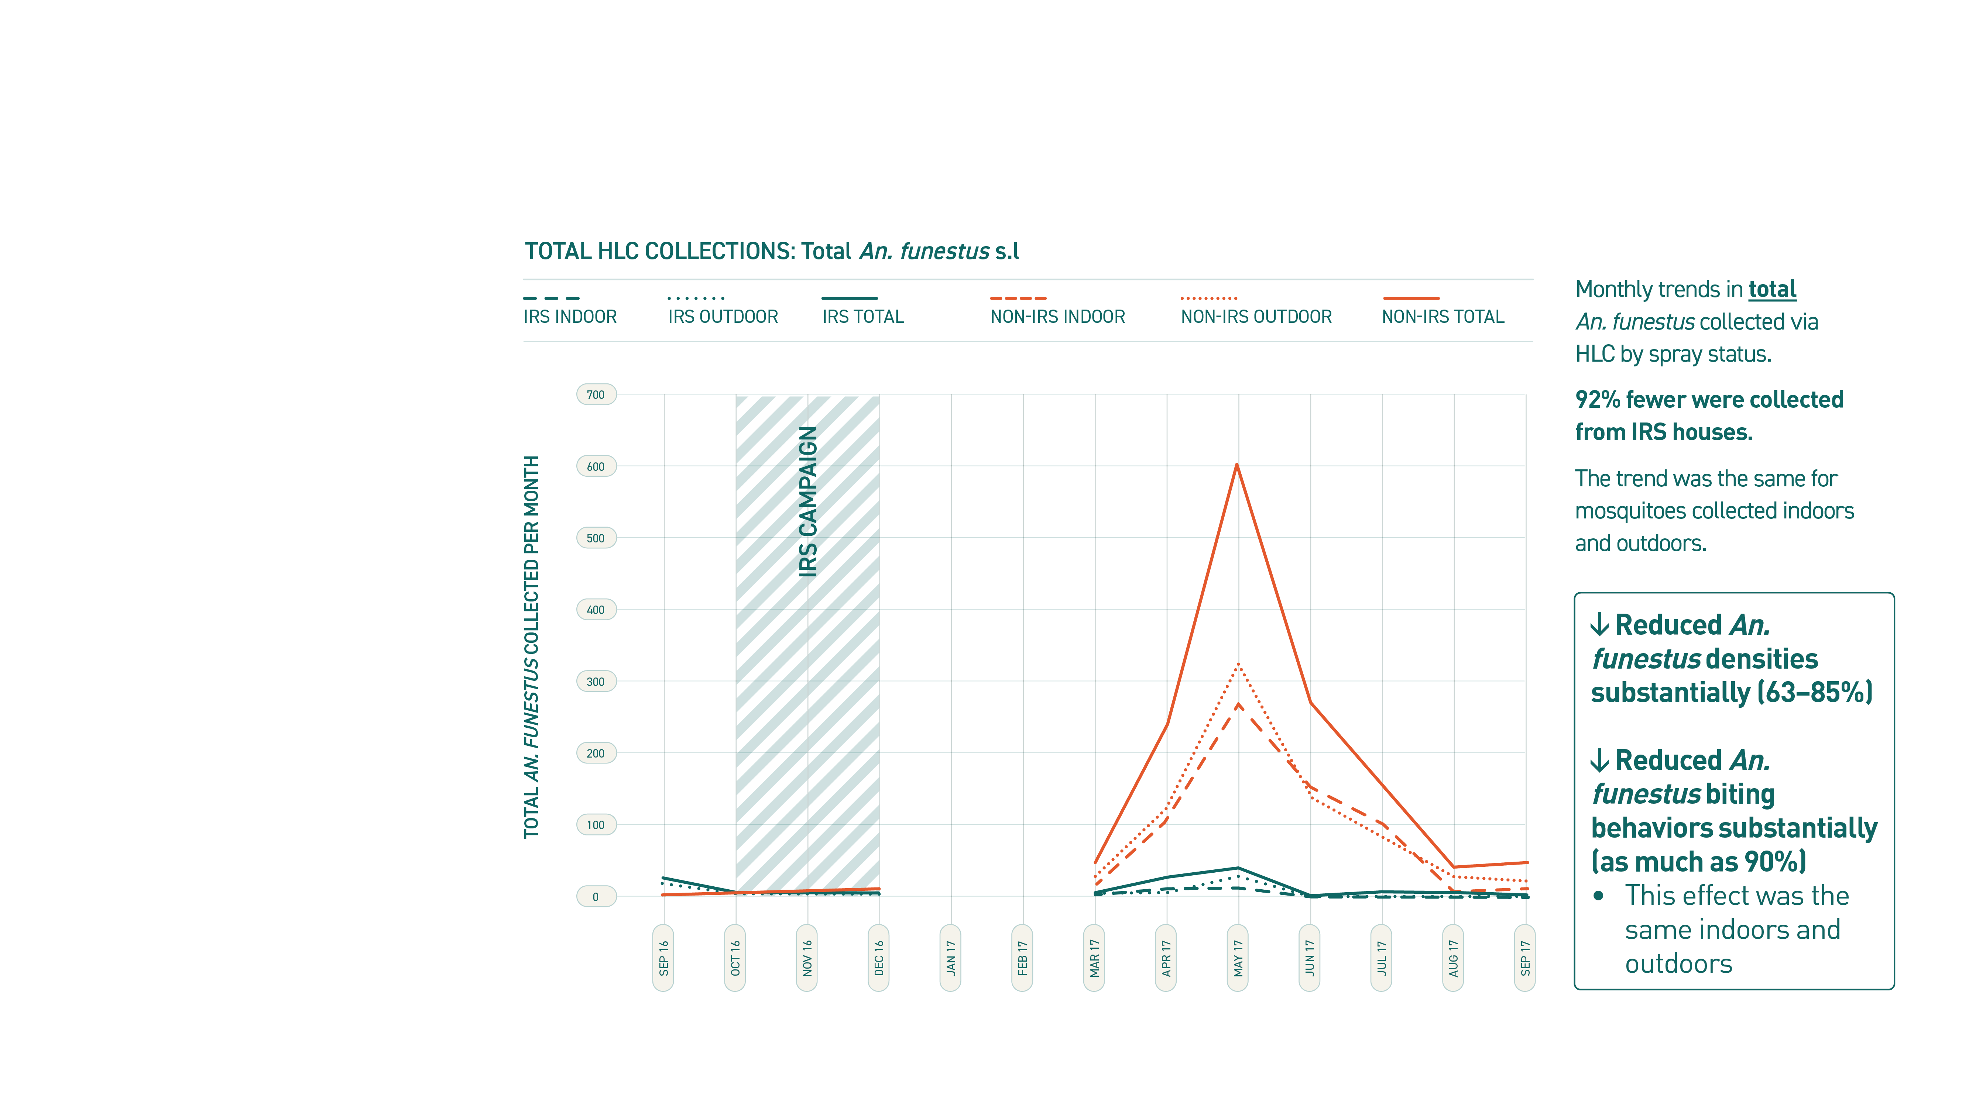
Notes:
3GIRS - Third generation IRS product effective against pyrethroid resistant vectors, with a residual efficacy of at least 6 months
HLC – Human Landing Catch
IRS – Indoor Residual Spraying
LLIN - Long Lasting Insecticidal Nets

Slide 11

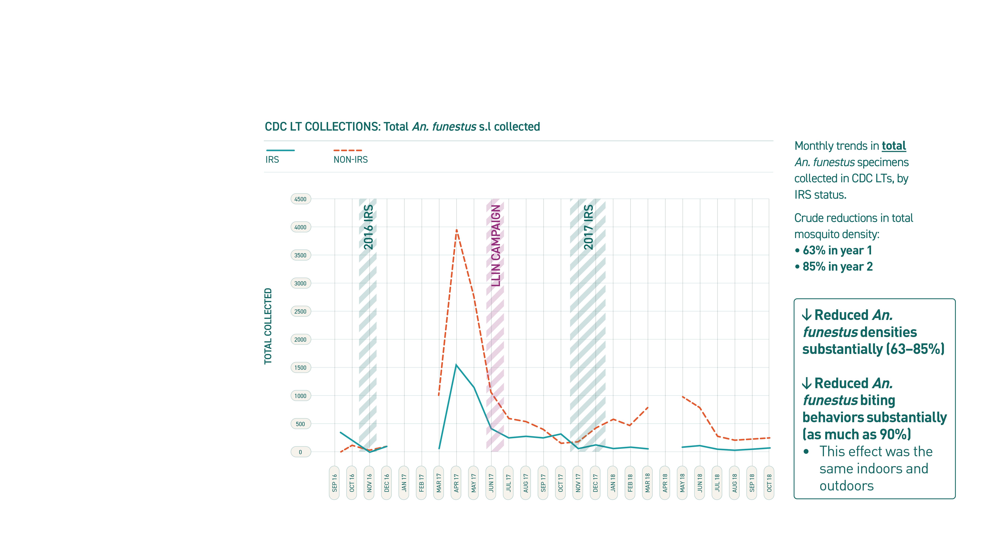
Notes:
3GIRS - Third generation IRS product effective against pyrethroid resistant vectors, with a residual efficacy of at least 6 months
CDC LT – Centres for Disease Control Light Trap
IRS – Indoor Residual Spraying
LLIN - Long Lasting Insecticidal Nets

Slide 12
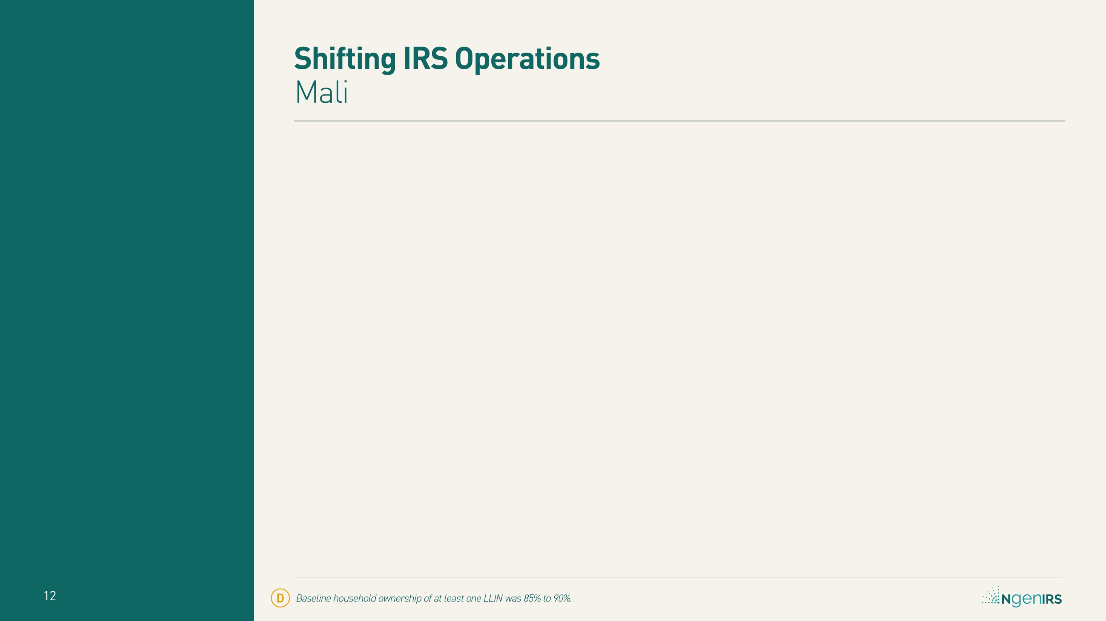

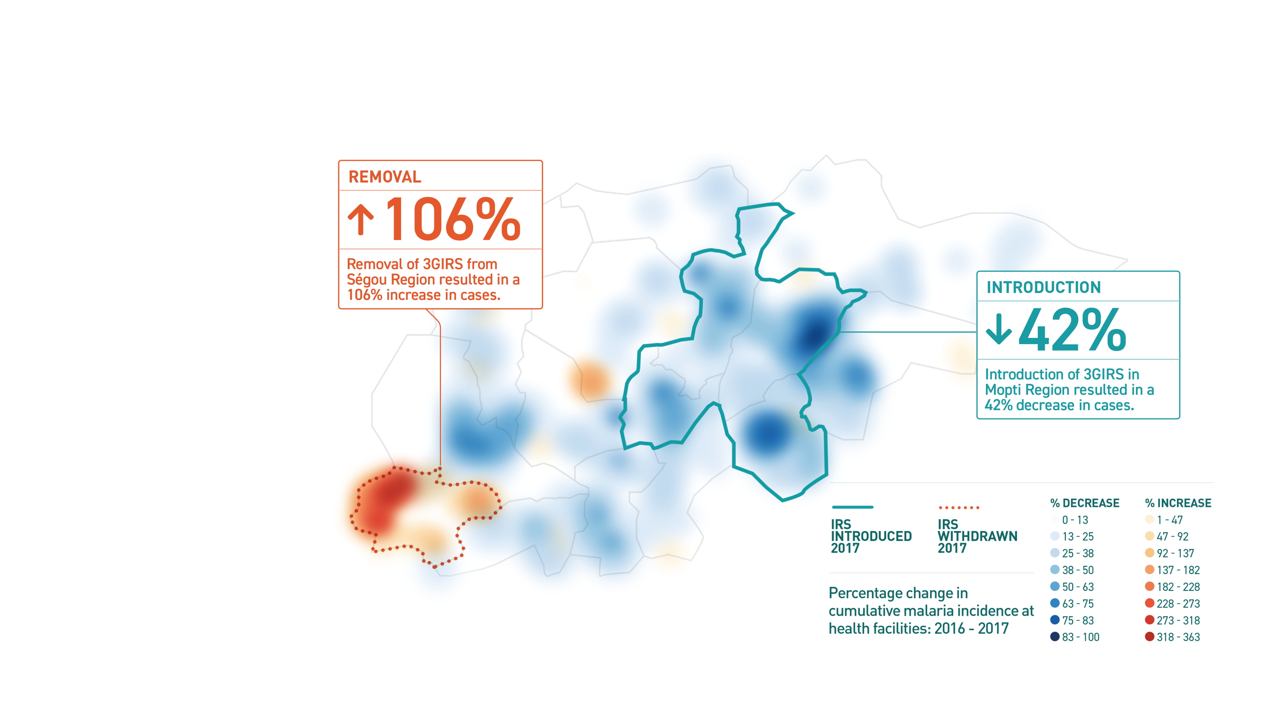
Notes:
Background incidence rates (in districts where there was no IRS in either year) fell an average of 22%, a significantly smaller margin than in the newly sprayed districts of Mopti (p = 0.040).
Baseline household ownership of at least one LLIN: 85% to 90%.
3GIRS - Third generation IRS product effective against pyrethroid resistant vectors, with a residual efficacy of at least 6 months
IRS – Indoor Residual Spraying
LLIN - Long Lasting Insecticidal Nets

Slide 13
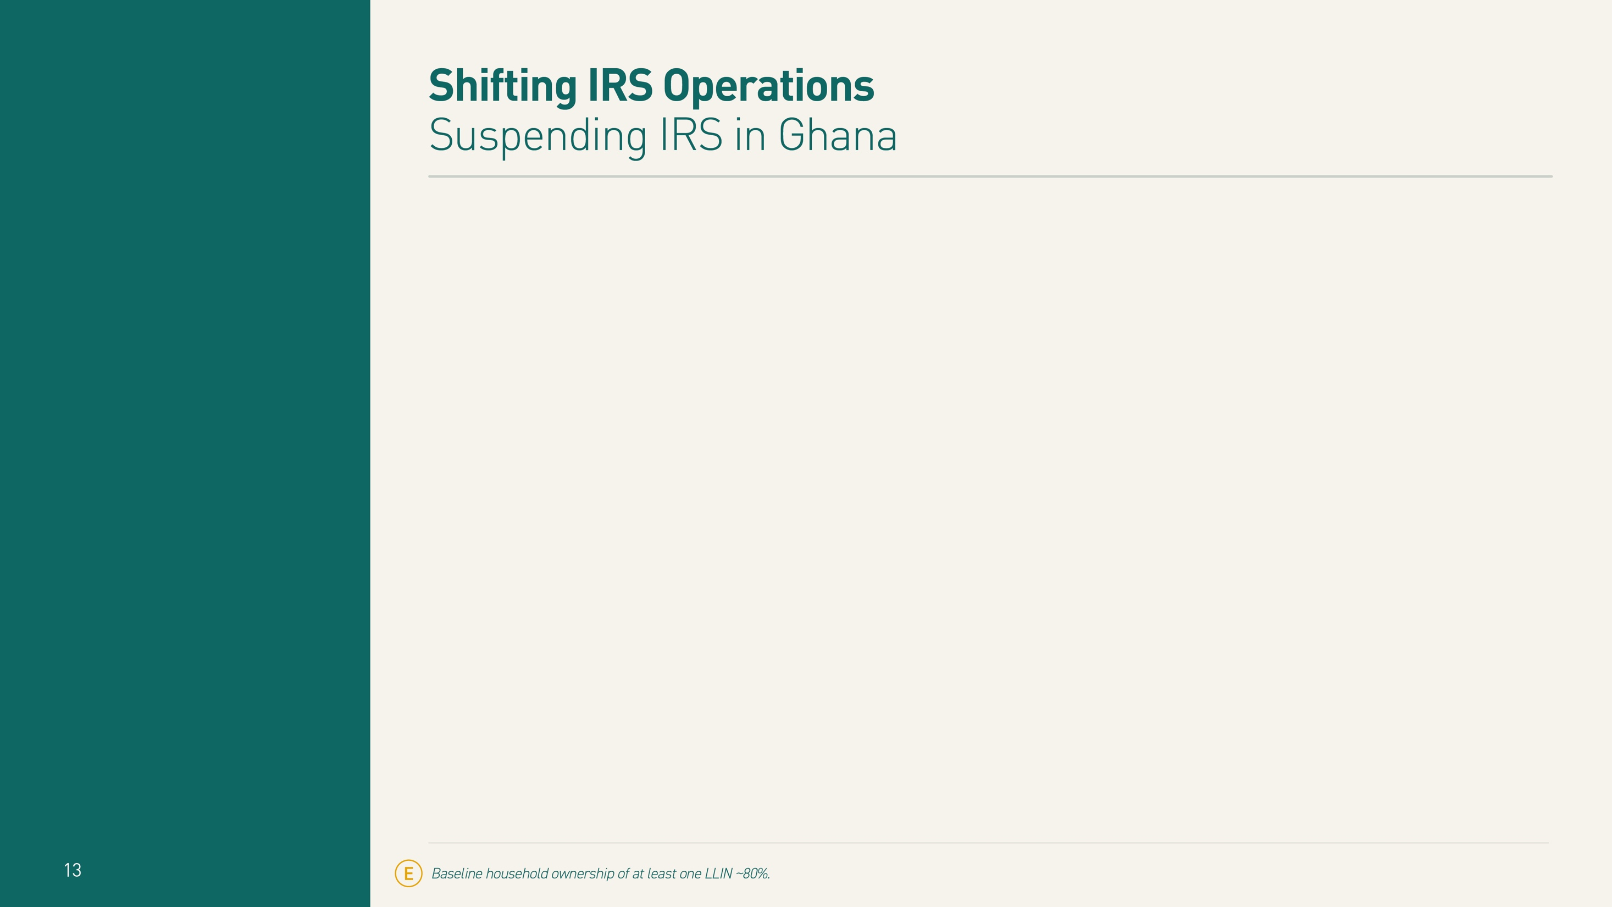

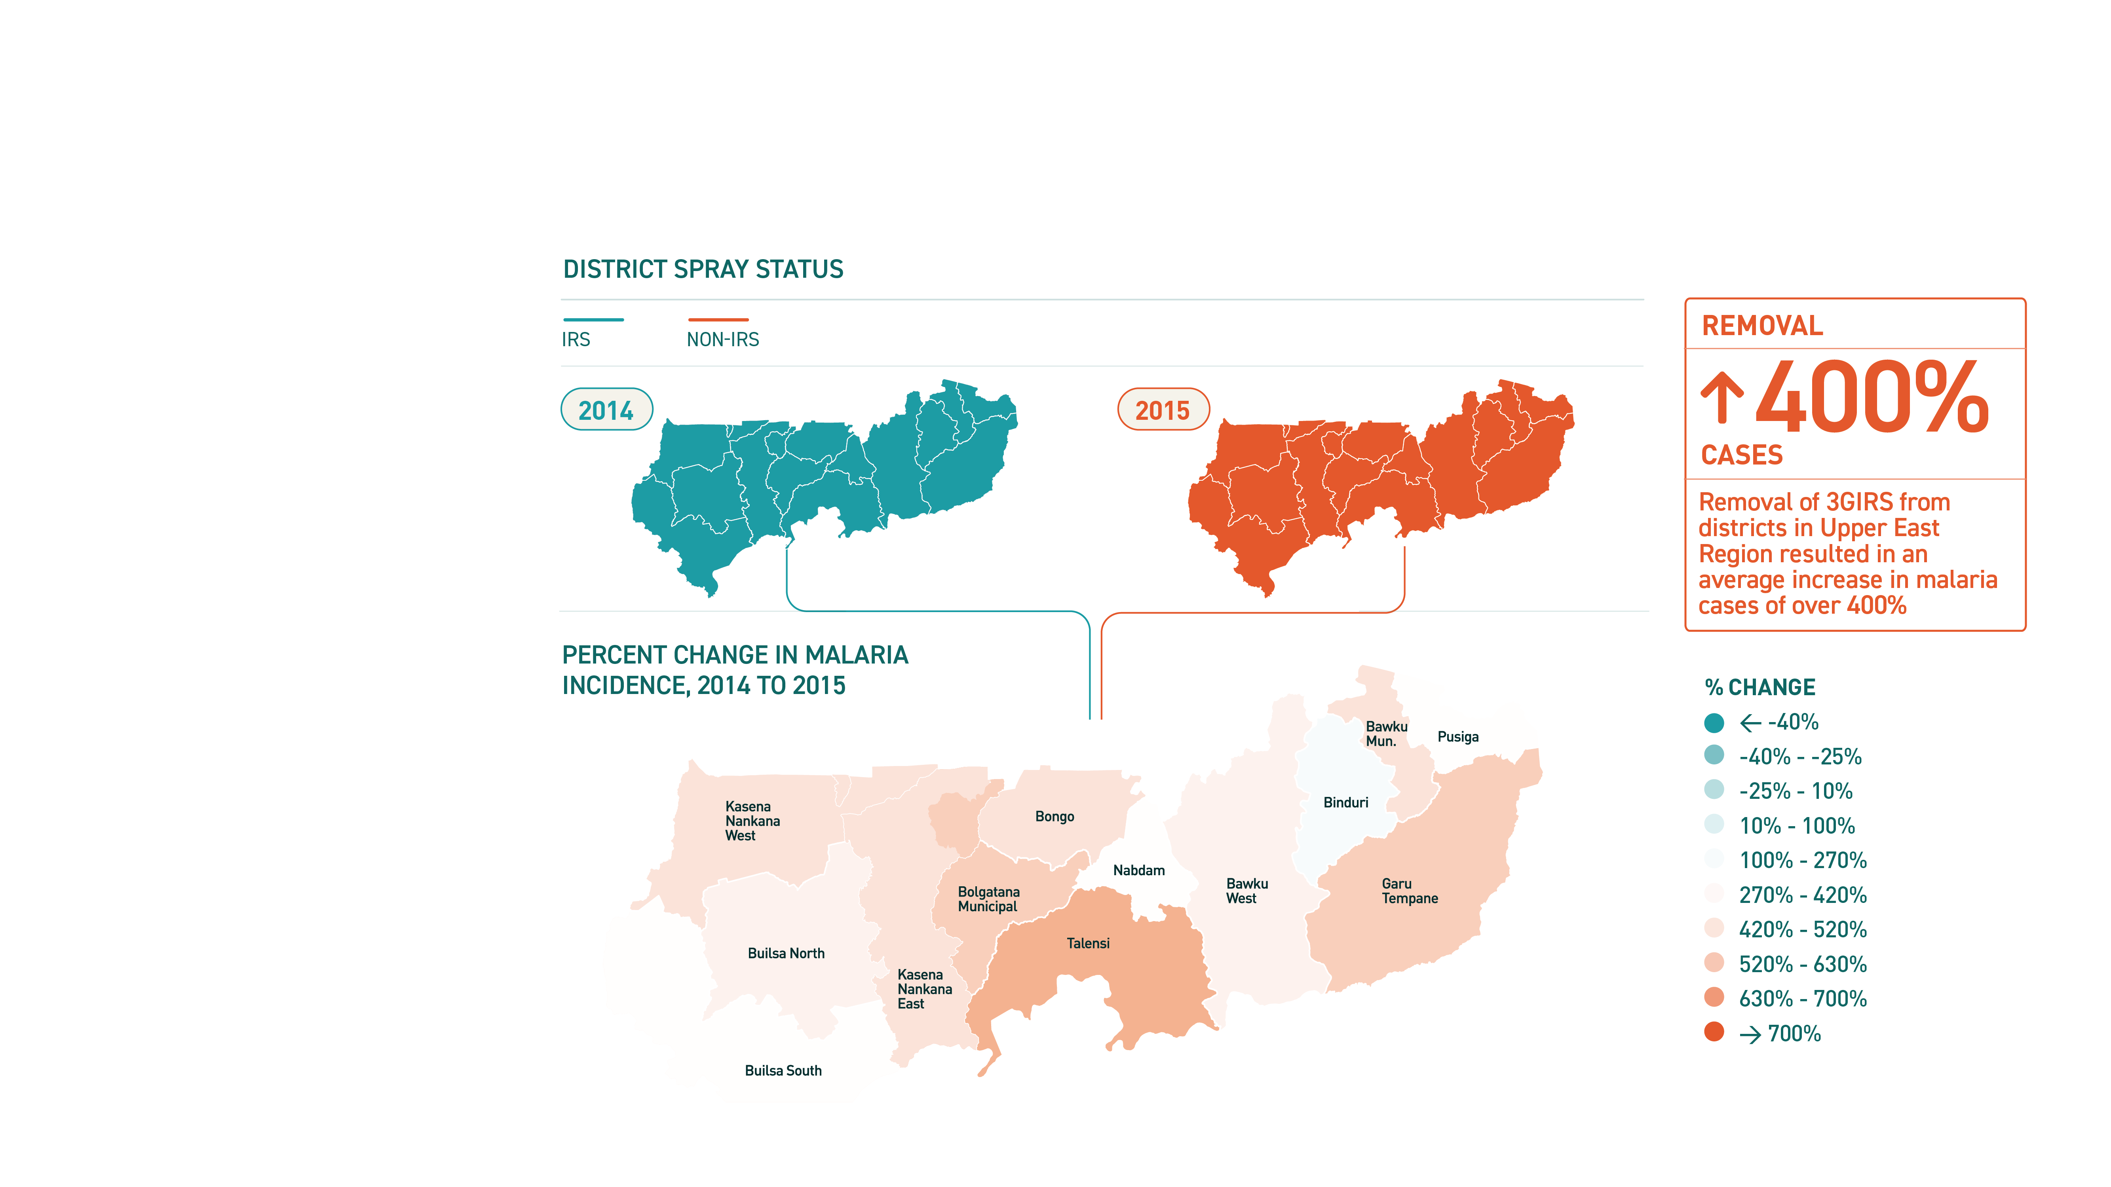
Notes:
After IRS was suspended, malaria incidence rates jumped an average of over 400% (95% CI 330% to 640%)
3GIRS - Third generation IRS product effective against pyrethroid resistant vectors, with a residual efficacy of at least 6 months
CI – Confidence Interval
IRS – Indoor Residual Spraying
LLIN - Long Lasting Insecticidal Nets

Slide 14
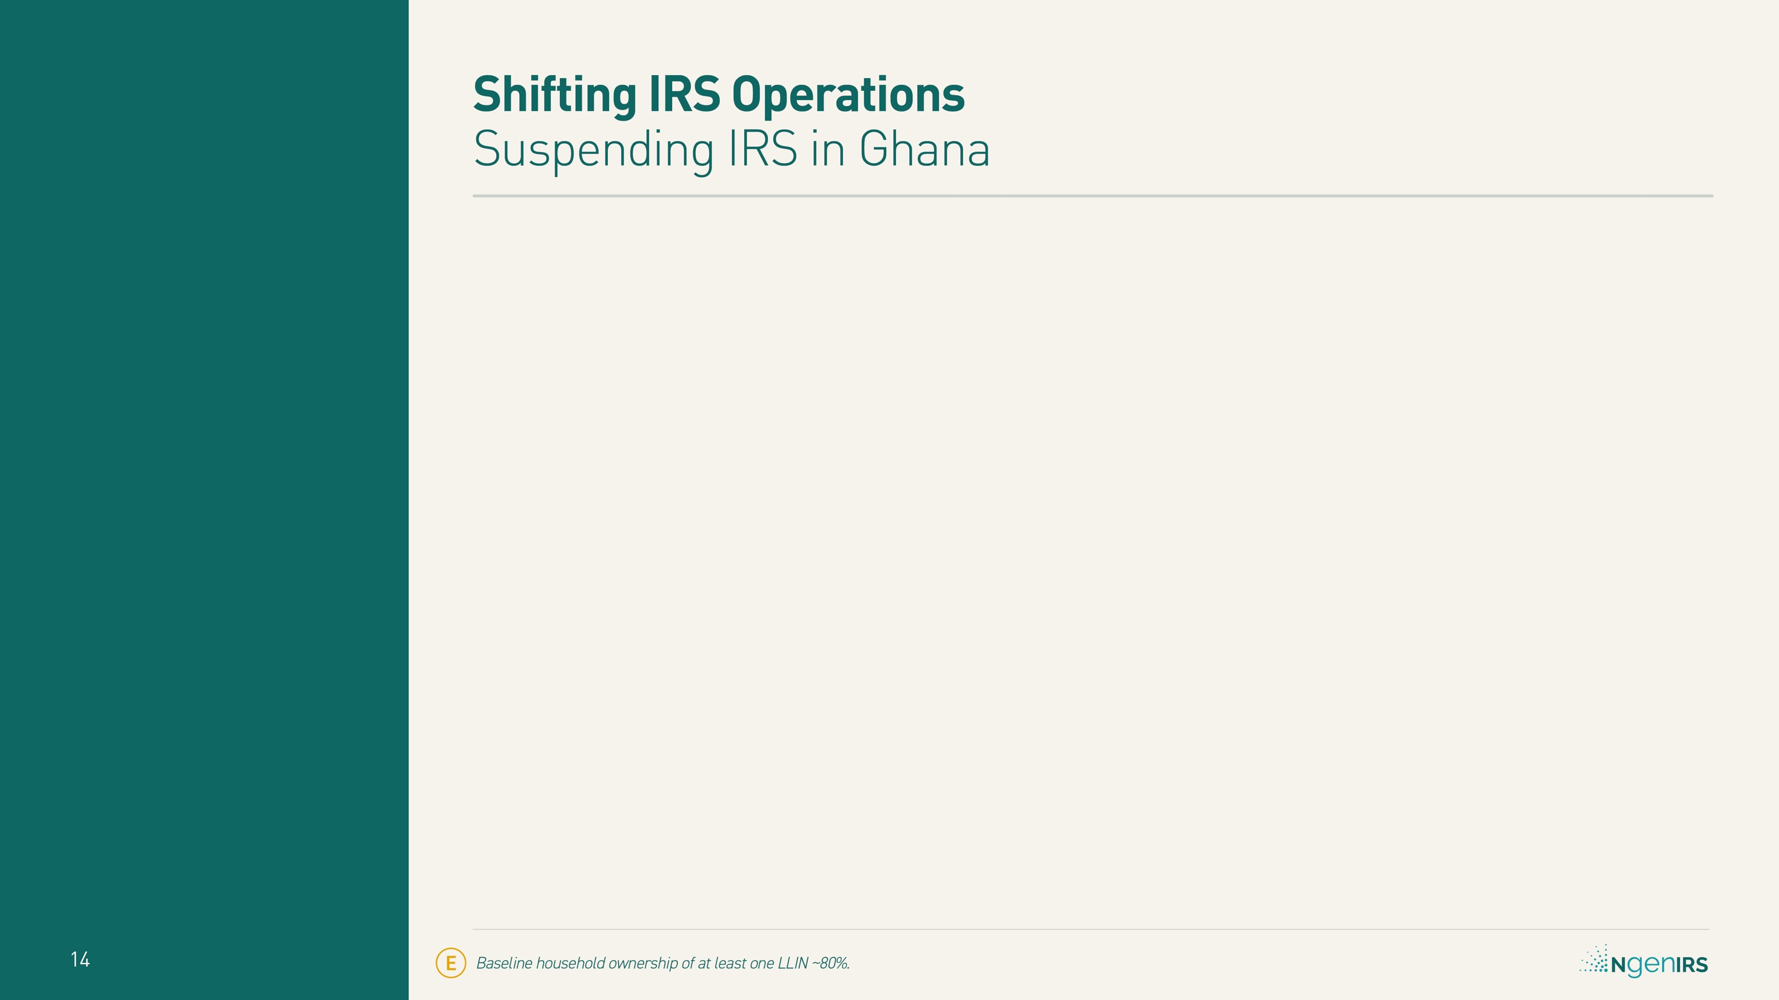
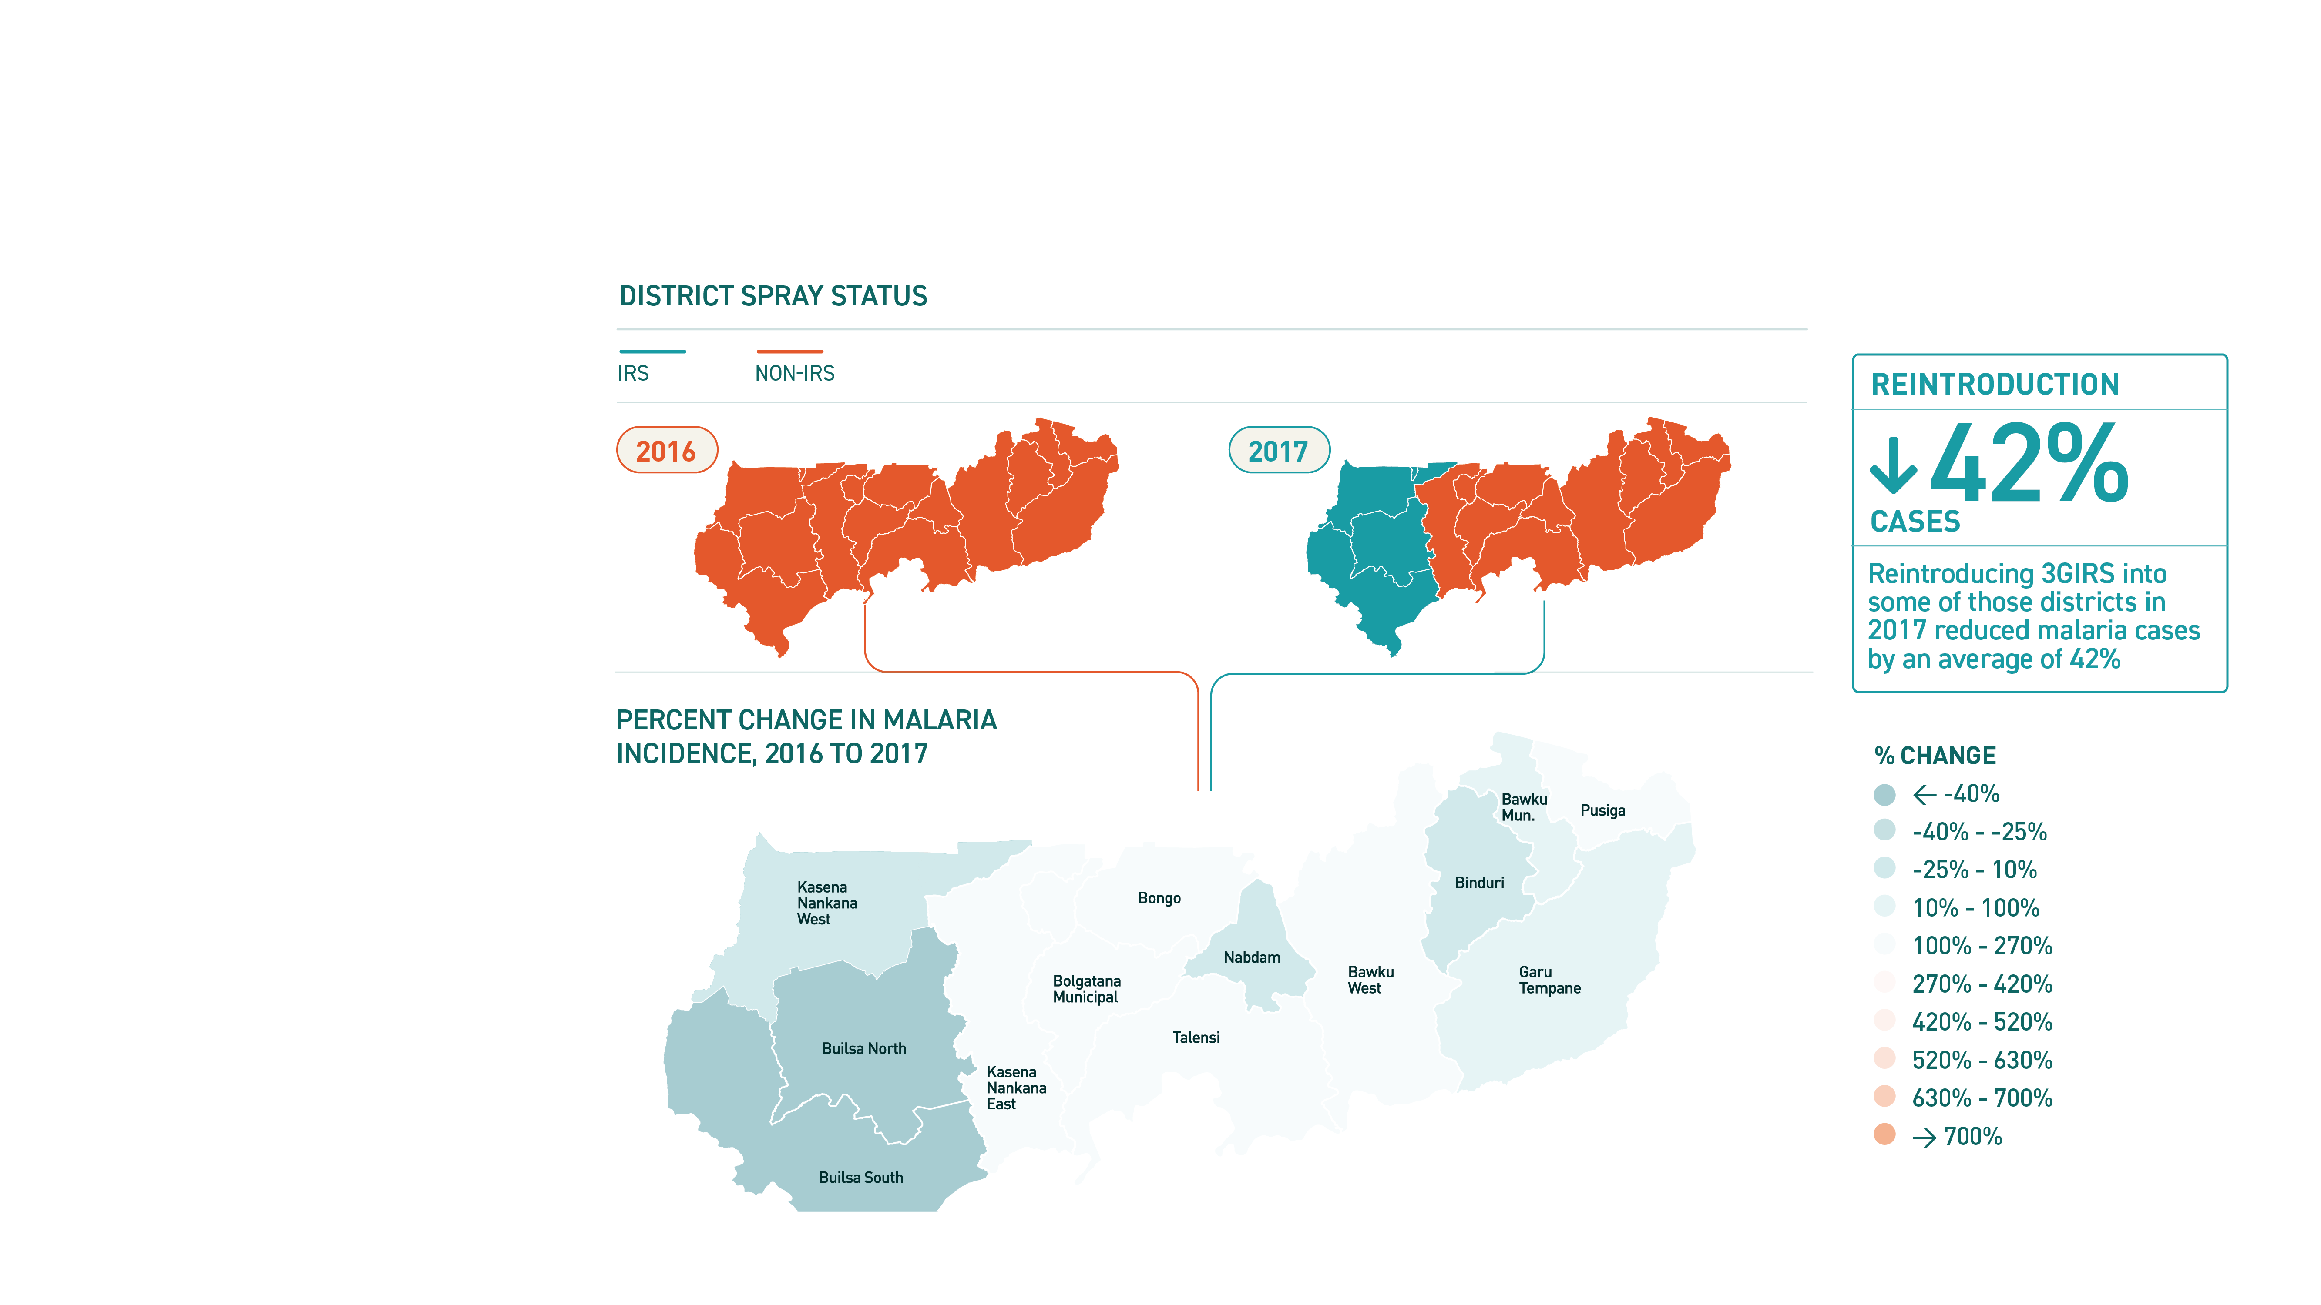
Notes:
In districts where IRS was reintroduced, malaria incidence fell 42% (95% CI: 28% to 56%).
In districts where there was no IRS in either year, malaria incidence fell 5% (95% CI: –6% to 15%).
3GIRS - Third generation IRS product effective against pyrethroid resistant vectors, with a residual efficacy of at least 6 months
CI – Confidence Interval
IRS – Indoor Residual Spraying
LLIN - Long Lasting Insecticidal Nets

Slide 15
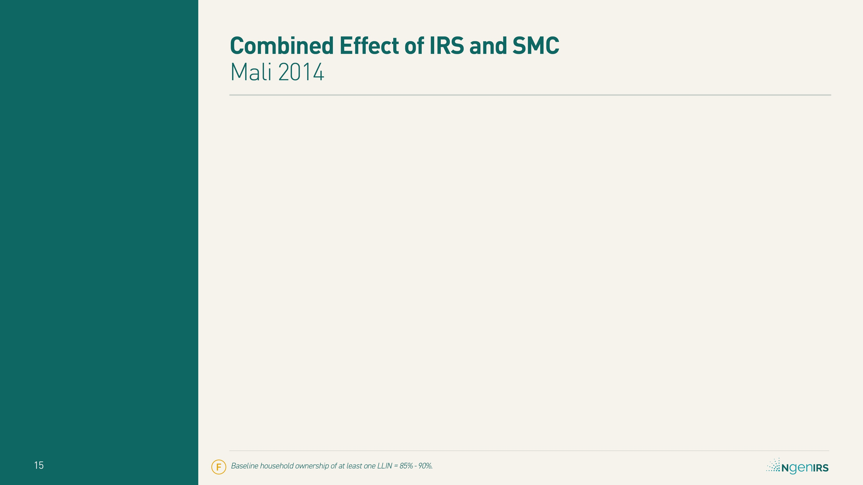

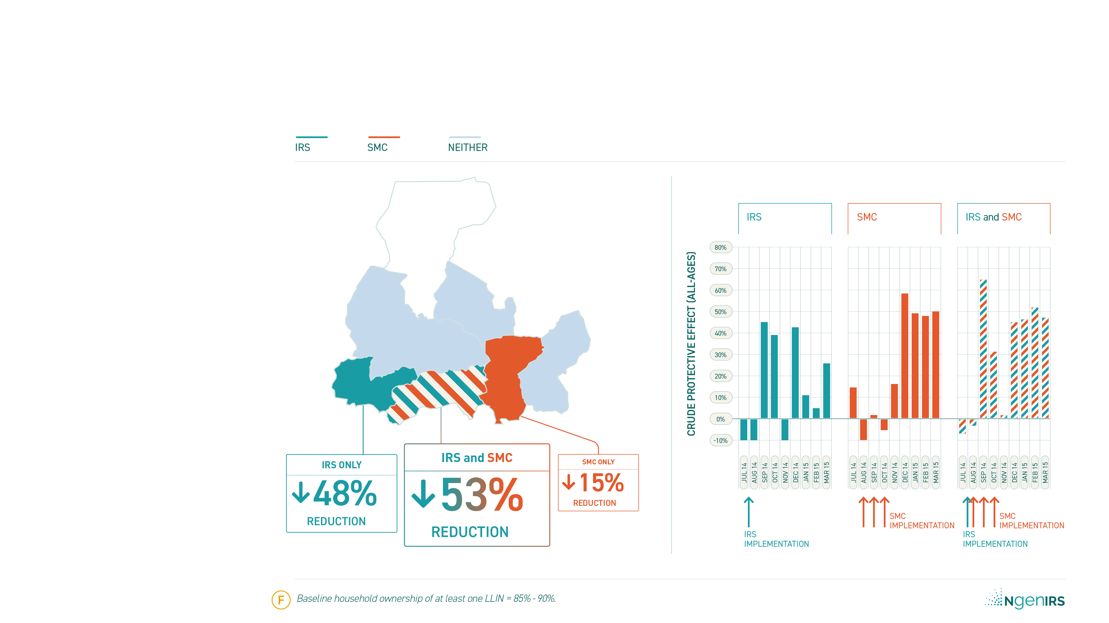
Notes:
In 2014, a combined effect for co-deploying IRS and SMC was suggested in Ségou.
Notice the chart of “crude protective effect” by month for each intervention package on the right:
IRS alone in Barouéli quickly produced a large impact that waned over time
the impact of SMC alone in San was modest at first but sustained for at least 6 months
the impact of IRS and SMC in Bla was both rapid and of longer duration – combining the best of both interventions.
(All age malaria incidence reduction is shown)
3GIRS - Third generation IRS product effective against pyrethroid resistant vectors, with a residual efficacy of at least 6 months
IRS – Indoor Residual Spraying
LLIN - Long Lasting Insecticidal Nets
SMC – Seasonal Malaria Chemoprevention

Slide 16
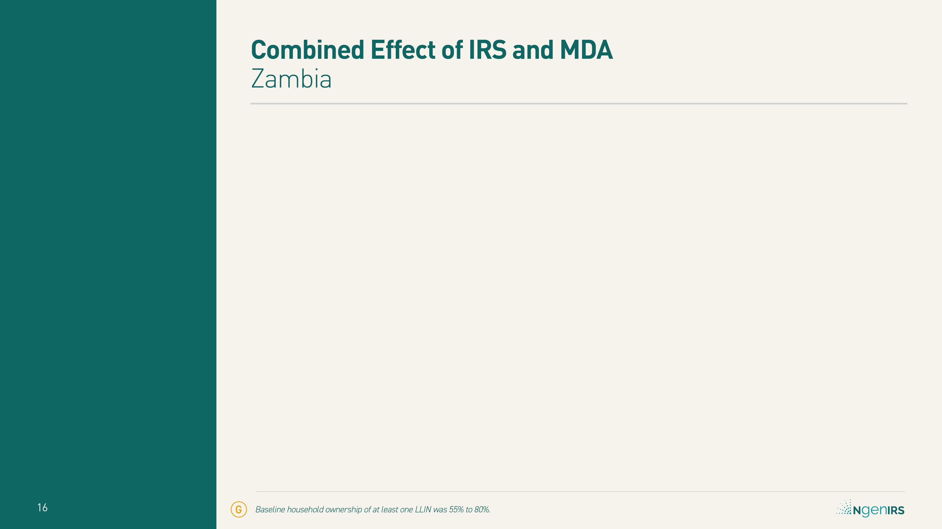

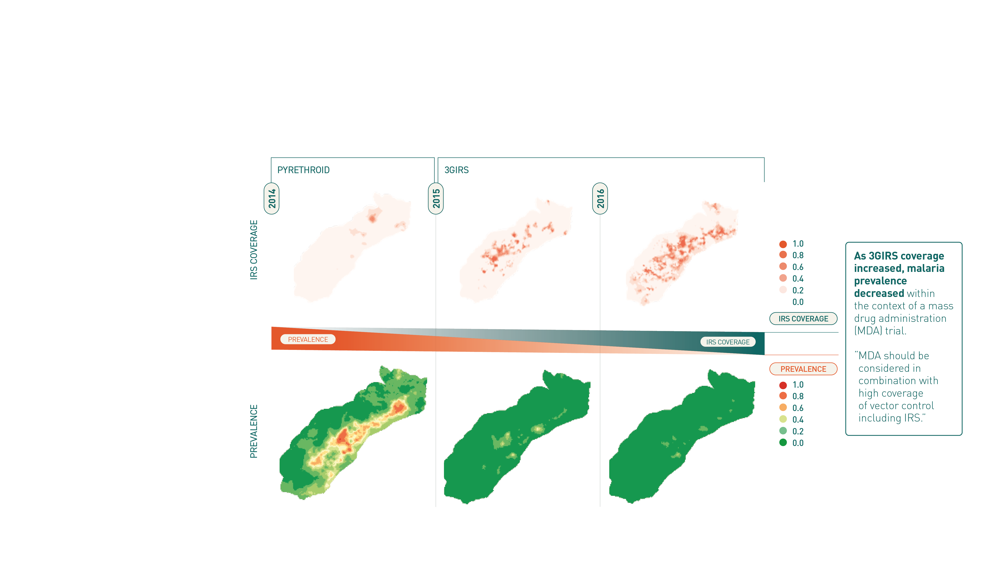
Notes:
3GIRS - Third generation IRS product effective against pyrethroid resistant vectors, with a residual efficacy of at least 6 months
IRS – Indoor Residual Spraying
LLIN - Long Lasting Insecticidal Nets
MDA – Mass Drug Administration

Slide 17
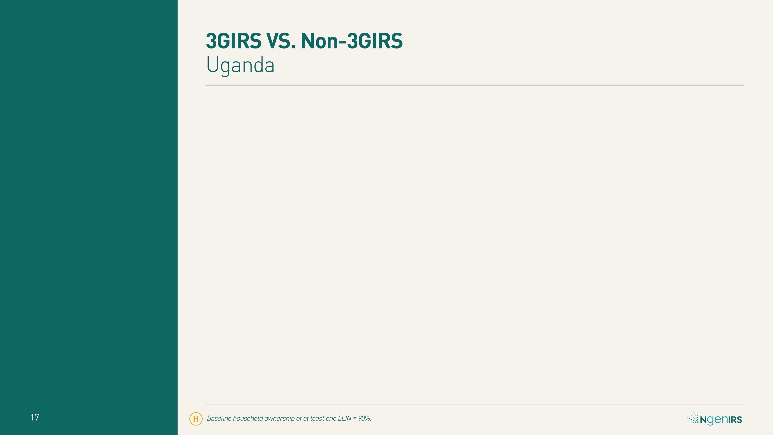

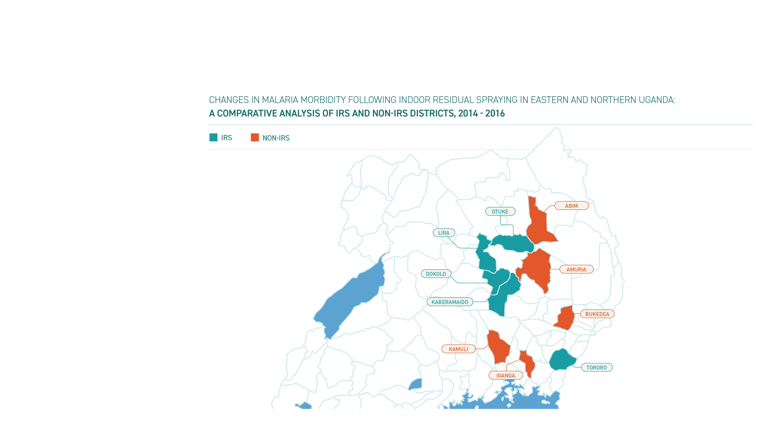
Notes:
Comparing the 5 IRS districts to the 5 comparator non-IRS districts, a single spray round with Actellic® 300CS in 2016 had more impact that multiple rounds of IRS with bendiocarb in 2015.
Though vectors were susceptible to both compounds, in Uganda the residual bio-efficacy of bendiocarb was between 3 – 4 months and for Actellic® 300CS was between 6 – 7 months.
(Dengela et al. Parasites & Vectors (2018) 11:71, and The PMI VectorLink Project. Uganda Annual Entomology Report, December 1, 2017–December 31, 2018)
3GIRS - Third generation IRS product effective against pyrethroid resistant vectors, with a residual efficacy of at least 6 months
CI – Confidence Interval
IRS – Indoor Residual Spraying
LLIN - Long Lasting Insecticidal Nets

Slide 18


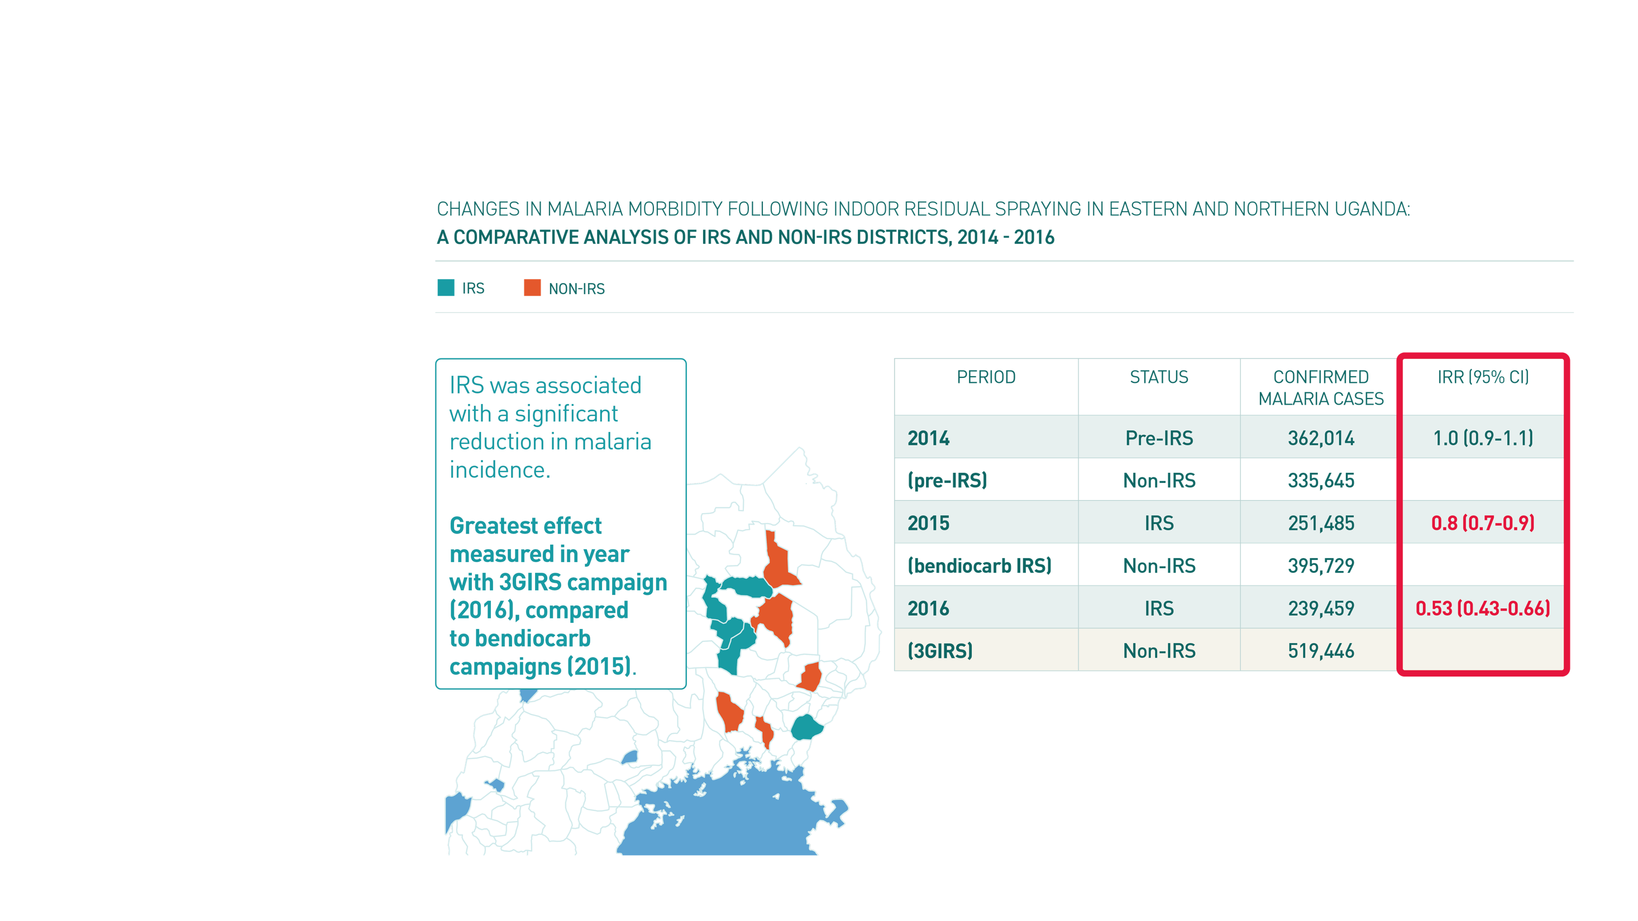
Notes:
Comparing the 5 IRS districts to the 5 comparator non-IRS districts, a single spray round with Actellic® 300CS in 2016 had more impact that multiple rounds of IRS with bendiocarb in 2015.
Though vectors were susceptible to both compounds, in Uganda the residual bio-efficacy of bendiocarb was between 3 – 4 months and for Actellic® 300CS was between 6 – 7 months.
(Dengela et al. Parasites & Vectors (2018) 11:71, and The PMI VectorLink Project. Uganda Annual Entomology Report, December 1, 2017–December 31, 2018)
3GIRS - Third generation IRS product effective against pyrethroid resistant vectors, with a residual efficacy of at least 6 months
CI – Confidence Interval
IRS – Indoor Residual Spraying
LLIN - Long Lasting Insecticidal Nets

Slide 19
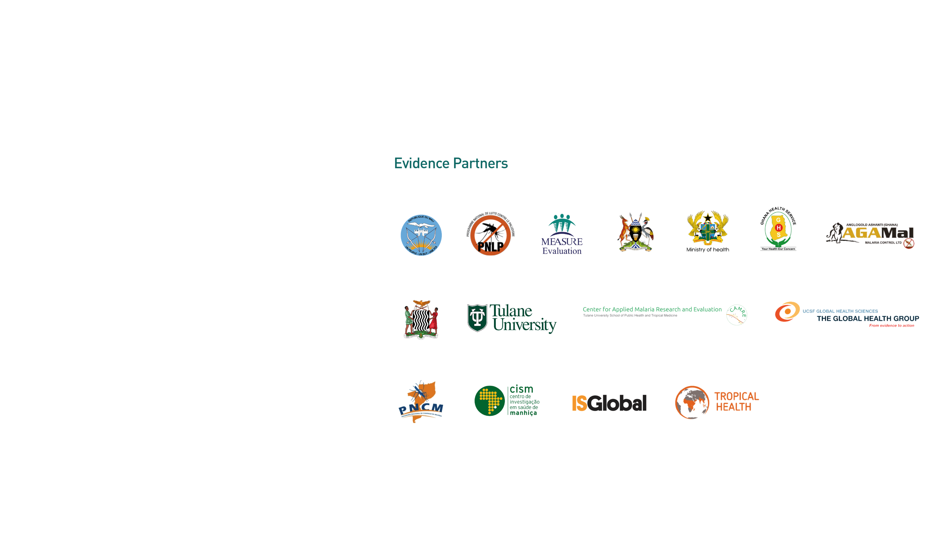
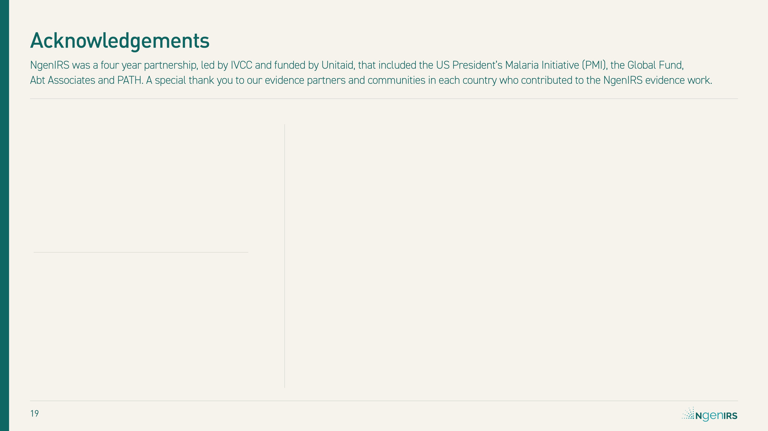



Slide 20
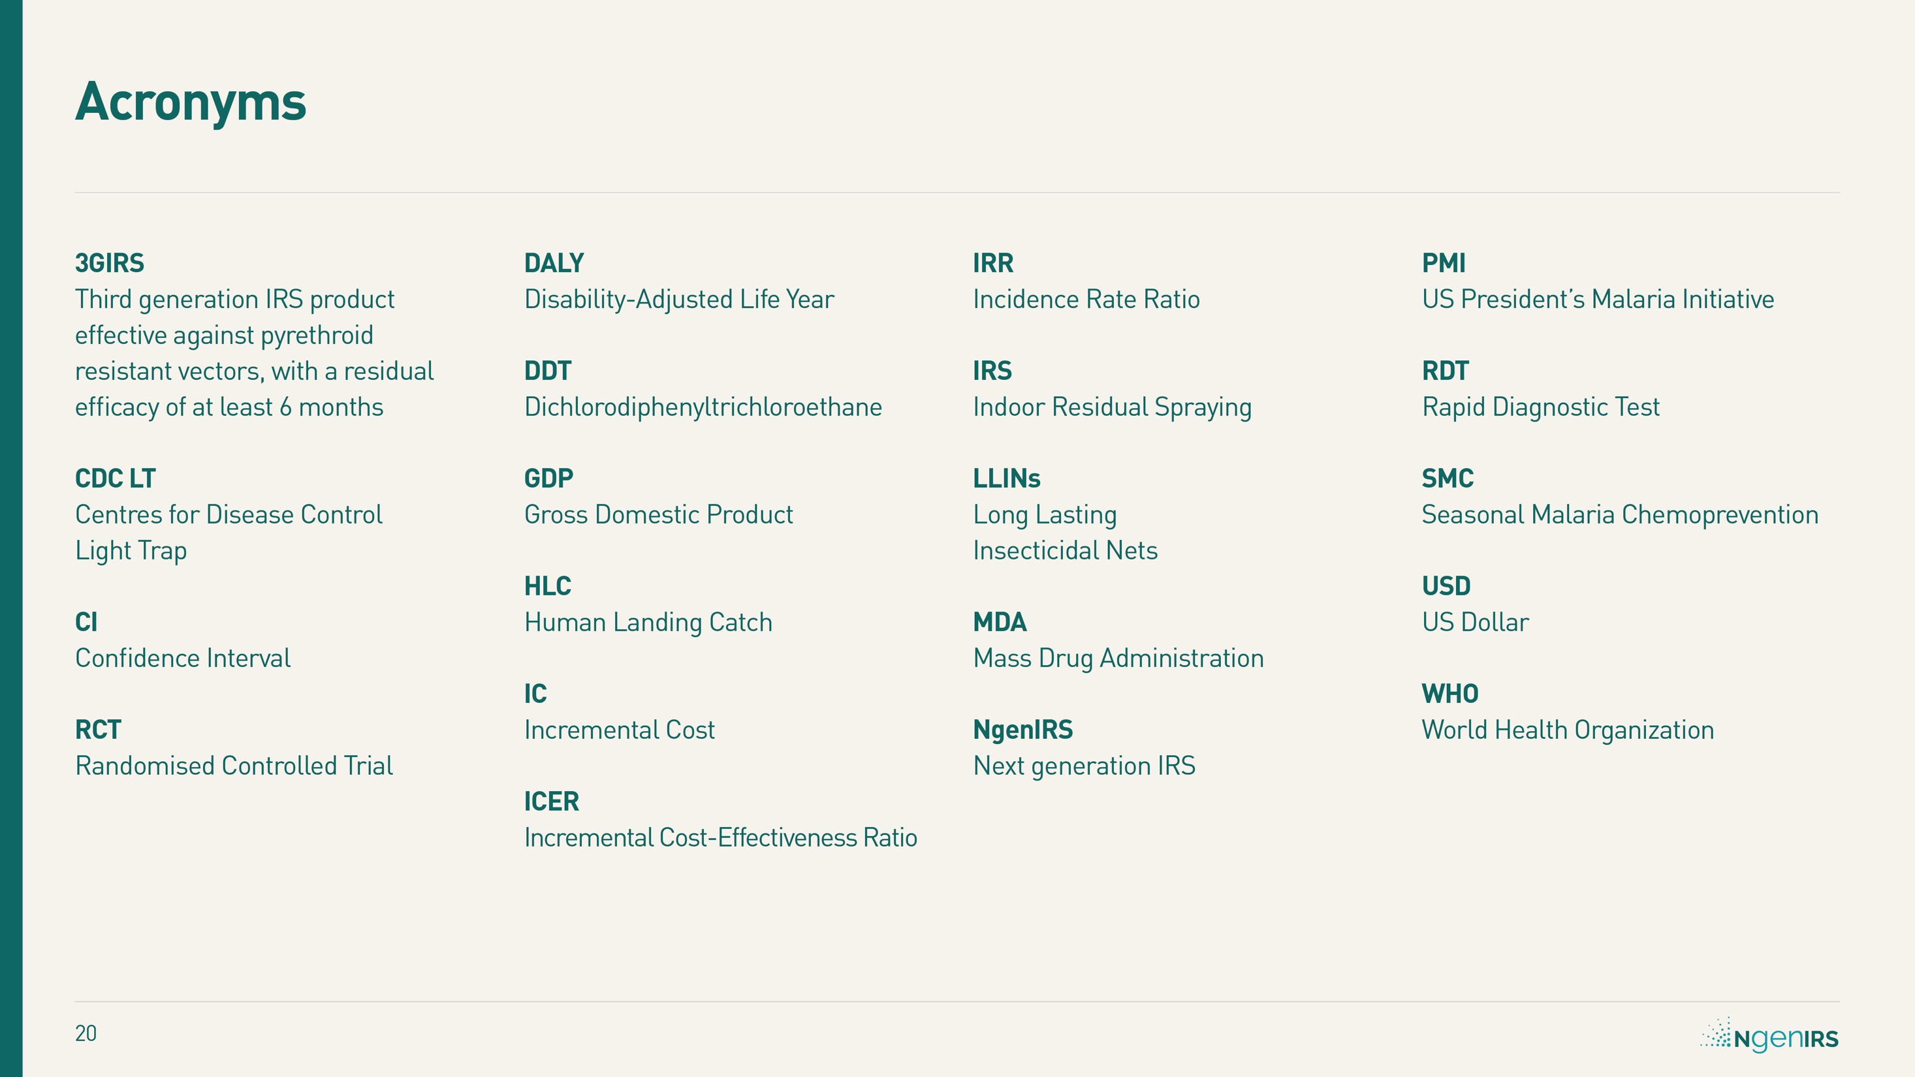

Slide 21
