Slide 1
Post-Market Surveillance (PMS) Toolkit
Julie-Anne Tangena
20th November 2025
RBM VCWG webinar

Slide 2
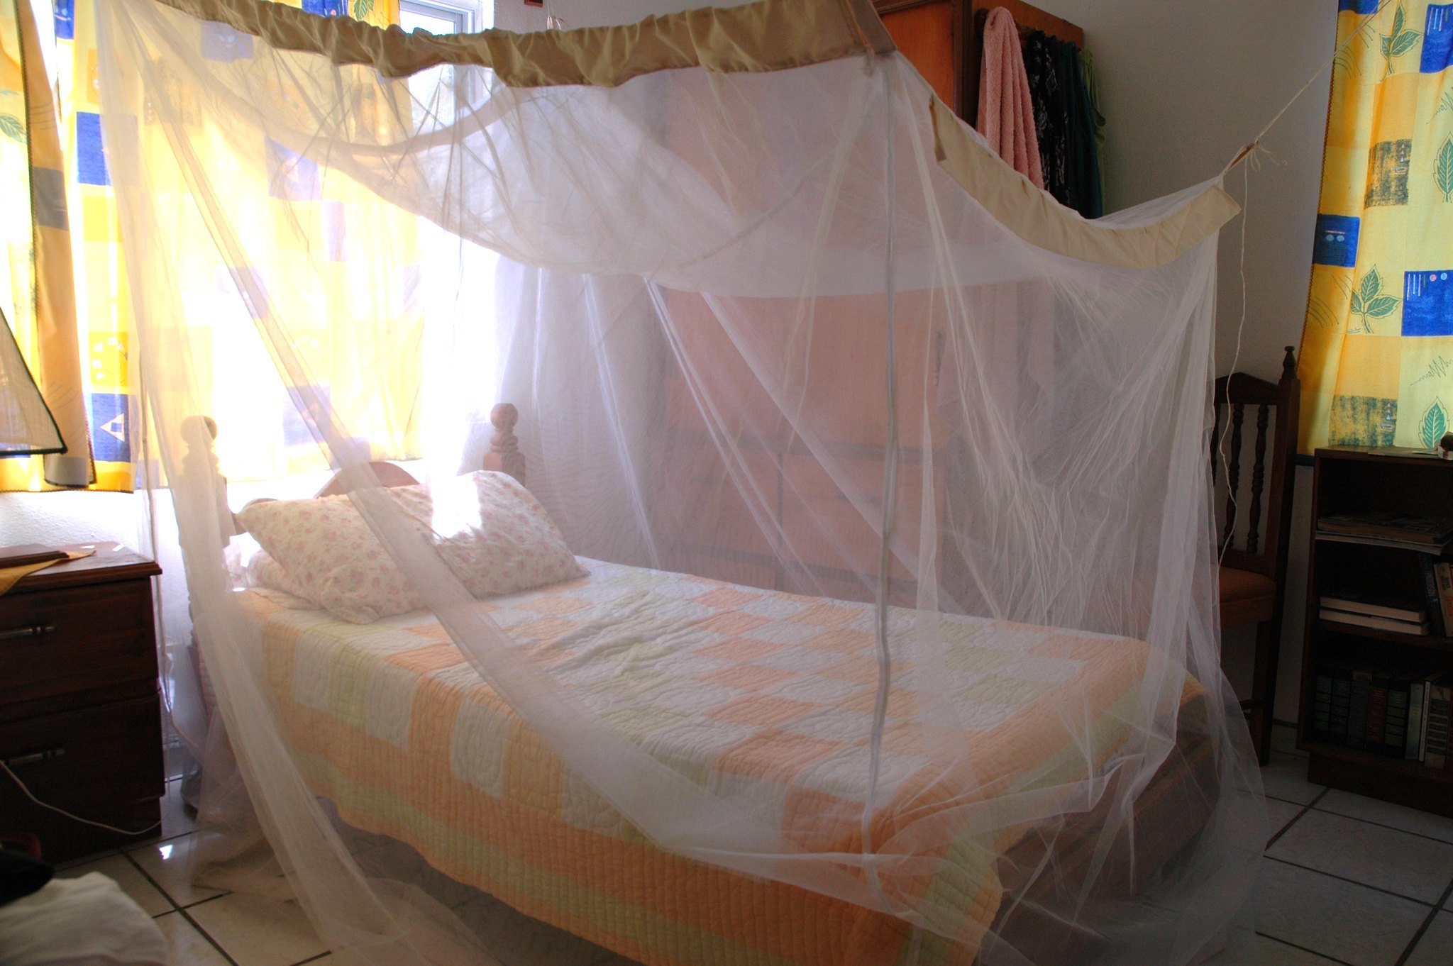
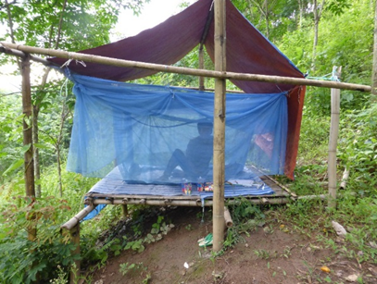

Understanding ITN dynamics in the field is essential
Since 2004 >3.4 billion ITNs have been distributed.
These nets vary physically and chemically, in yarn type, chemical treatment, knitting pattern, and size.
Net settings are highly diverse, varying by climate, housing design, and household conditions.
Users and communities are also highly diverse, varying in culture, behaviour, perceptions, and handling.
Flickr, Wonderlane 2009
© The Global Fund / John Rae

Slide 3
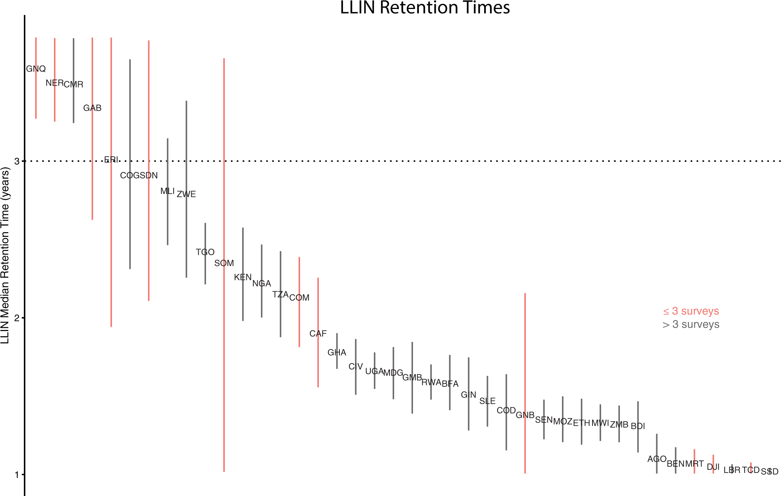
ITNs are not lasting as long as expected
Three years is the expected lifespan of ITNs.
>50% report less than 2 years lifespan*.
Large variability across net types and areas.
Essential to understand how long ITNs are lasting, accepted and effectively protecting communities for decision making
*Bertozzi-Villa A, Bever CA, Koenker H, Weiss DJ, Vargas-Ruiz C, Nandi AK, et al. Maps and metrics of insecticide-treated net access, use, and nets-per-capita in Africa from 2000-2020. Nature Communications. 2021; 12:3589.

Slide 4
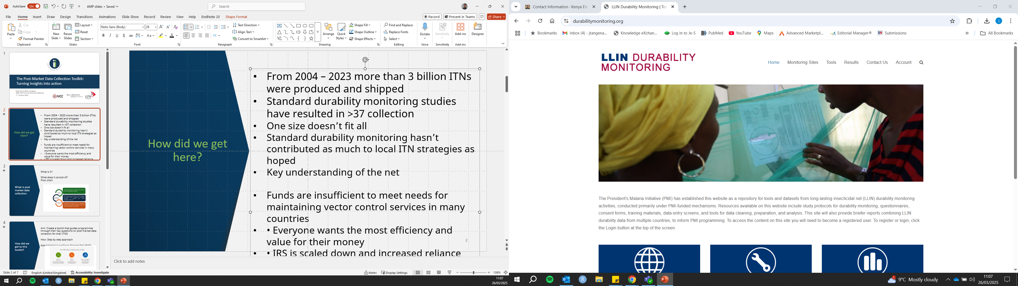
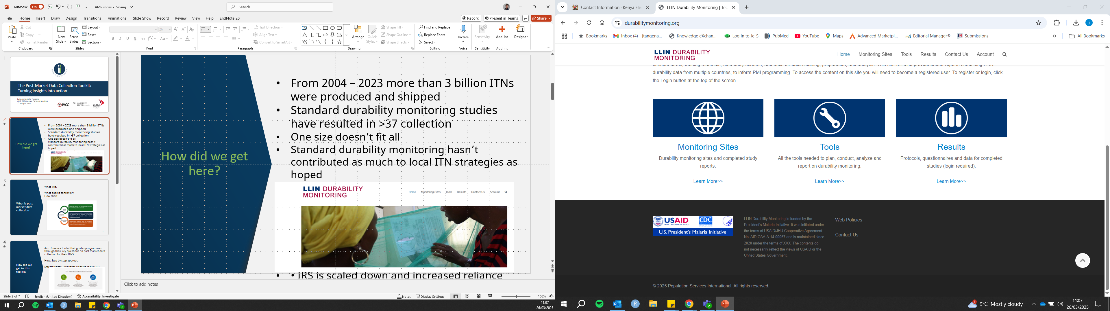
Insufficient resources for durability monitoring
Durability monitoring requires high level of resources and skills.
Challenges in translating data into decisions.
One size doesn’t fit all.
→ Further exacerbated by recent funding cuts.
How can we help country programs collect the information they need for tailored decisions in a complex ITN landscape under severe resource constraints?
Notes:
DM is gold standard

Slide 5
Need for toolkit for guidance on ITN durability surveillance
Listening exercises done in 2022 by Innovation 2 Impact (I2I) with five country programmes (Burkina Faso, Pakistan, Malawi, Uganda, Nigeria).
Need more granular durability monitoring data for targeted decisions (SNT).
Budget constraints call for more tailored monitoring focussed on key programmatic decisions.
Ensure the collected data is utilized to its fullest potential.
→ There was a clear call for guidelines that help identify and collect durability indicators for country decision-making.

Slide 6
Need for toolkit for guidance on ITN durability surveillance
Listening exercises done in 2022 by Innovation 2 Impact (I2I) with five country programmes (Burkina Faso, Pakistan, Malawi, Uganda, Nigeria).
Need more granular durability monitoring data for targeted decisions (SNT).
Budget constraints call for more tailored monitoring focussed on key programmatic decisions.
Ensure the collected data is utilized to its fullest potential.
→ There was a clear call for guidelines that help identify and collect durability indicators for country decision-making.
To summarize:
Wide diversity in ITNs (materials, environments, users)
Shorter net longevity then expected in many settings
Full durability monitoring studies are costly and unsustainable in the current funding landscape
Practical tool is needed to guide efficient, evidence-based monitoring
PMS toolkit

Slide 7
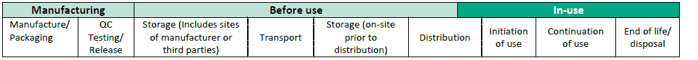
What is Post-Market Surveillance (PMS)?
According to ITN PMS document from WHO, the net life cycle:
Manufacturing: raw materials to product release
Before use: Storage, transport and distribution
In-use: Household use → end of ITN life
Purpose of PMS:
Monitor net performance in real-world conditions
Identify factors affecting durability & effectiveness
Support stakeholders in improving vector control decision-making
PMS

Slide 8



The PMS toolkit
The toolkit helps NMPs to:
Prioritize indicators within available resources
Use standardized methods to assess ITN durability
Interpret data in programmatic context
Align data collection with decision-making needs
How: Modular approach inspired by the Entomological Surveillance Planning Tool (ESPT) developed by Malaria Elimination Initiative
Focus on: Programmatic decisions/actions related to procurement, distribution, monitoring.

Slide 9
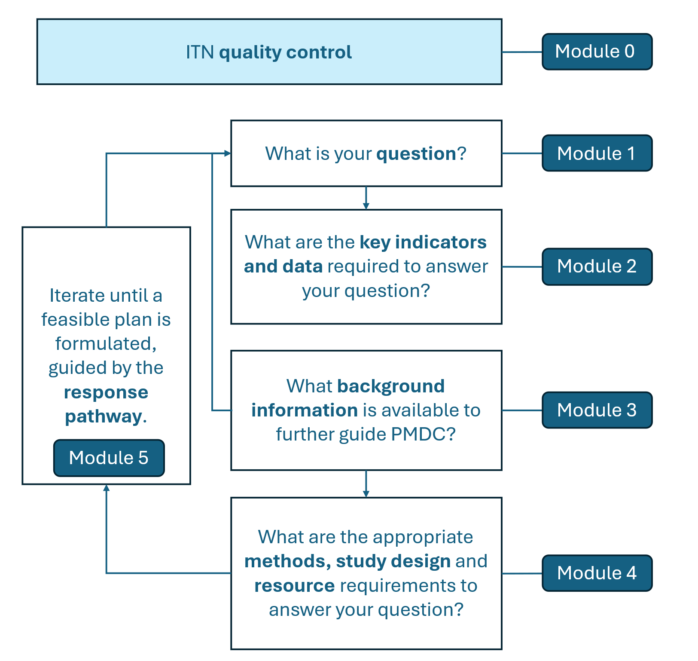
The PMS toolkit
Includes a glossary of key terms
Notes:
Highlight module 0 here

Slide 10
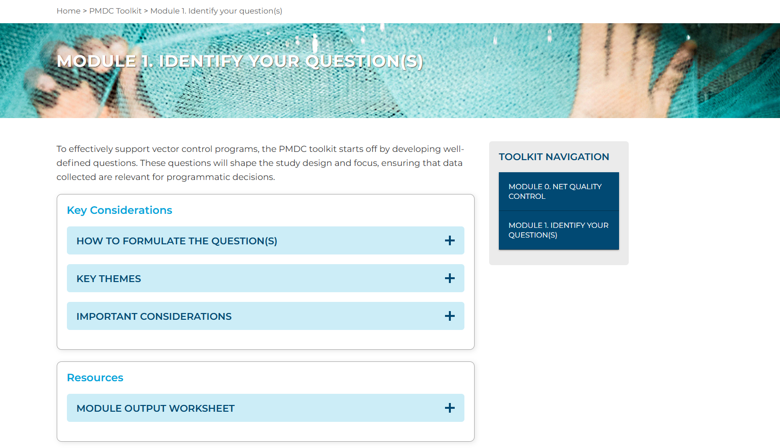

Slide 11
The PMS toolkit
Notes:
Highlight module 0 here

Slide 12
Module 1: what is your question?
Frequency of ITN distribution campaigns
What proportion of ITNs distributed in the past mass campaign are still present in good condition in the households?
Retrospective cross sectional
Two districts with the highest malaria incidence
How to define your question(s)
Step 1: Define the decision
Step 2: Translate the decision into questions
Step 3: Organize by theme:
Physical durability
Insecticidal/chemical activity
Net use and individual behaviours
Net use setting
Step 4: identify the study design
Step 5: Study area

Slide 13
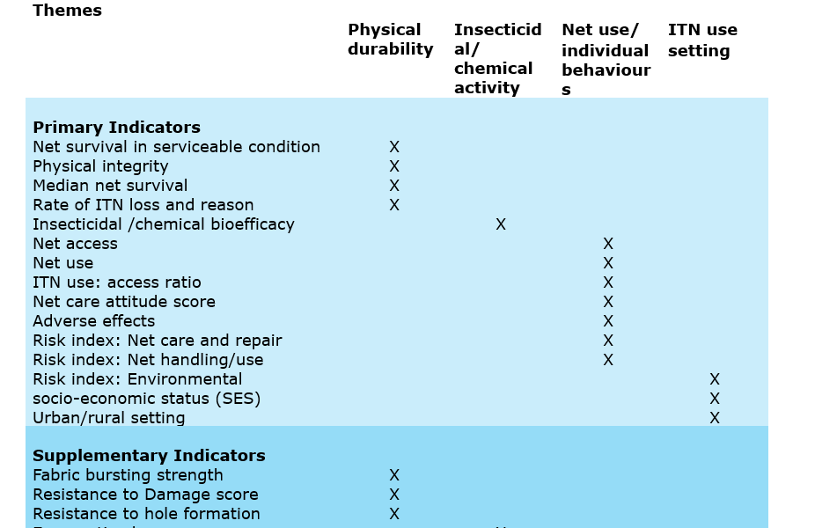
Module 2: what are your key indicators and data?
How do you identify your key indicator and data needs?
Step 1: Report your programmatic decisions, key questions and themes
Step 2: Identify relevant indicators
What proportion of ITNs distributed in the past mass campaign are still present in good condition in the households? Physical durability
Net survival in serviceable condition

Slide 14
Module 3: What background information is available?
Unknown if the same net type has been used elsewhere
NMP’s from other countries, academics, procurers, manufacturers
PubMed, public reports from stakeholders, DM reports
Same net type was used in neighbouring countries, where median lifespan was 1.2 to 2.6 years
Low acceptance or very low chemical durability identified: could prompt expansion of indicators
How to summarize key findings from existing data sources:
Step 1: Identify gaps.
Step 2: Engage stakeholders
Step 3: Investigate online resources.
Step 4: Synthesize information.
Step 5: Refine question(s) and indicators.

Slide 15
Module 4: What is your method, study design, resource requirements?
Budget in M&E, ITN campaigns, funding opportunities.
Attrition surveillance
Are at least 60% of ITNs distributed in the last 24 months still in good condition (serviceable)?
Use data from prior durability monitoring studies where possible: calculate costs
Re-iterate process if cost exceeds resources
Step 1: Review available resources in country
Step 2: Select data collection methods.
Step 3: Define decision criteria.
Step 4: Calculate sample size.
Step 5: Iteration of your steps

Slide 16



Module 5: What is your response pathway?
How to plan the response:
Step 1: Review indicators and methods.
Step 2: Confirm decision criteria.
Step 3: Define data flow and use.
Step 4: Apply the traffic light system for action.
Step 5: Decide on actions.
 | STOP Findings exceed thresholds and require immediate action or change in ITN strategy. |  | SLOW Findings are concerning but not conclusive. Further investigation and additional data are required. |  | GO Findings meet expectations. Continue as planned until conditions change.

Slide 17
Module 5: Example
Indicator: Attrition rate at 24 months.
Decision criteria: Attrition ≤ 50% considered acceptable.
Traffic light | Threshold | Possible actions
STOP | > 60% | Direct engagement with Ministry of Health, donors, and stakeholders to revise ITN strategy.
SLOW | 40-60 % | Conduct further monitoring, gather additional data (e.g., reasons for attrition such as retention, household practices, or environmental conditions).
GO | < 40% | No further monitoring required until a new ITN type is introduced or malaria indicators change.

Slide 18
The PMS Toolkit: A practical decision-making resource
It helps NMPs plan, conduct, and interpret ITN PMS:
Centralizes key resources for easier access and use (modular approach or resource)
Empowers programs to design adaptable, locally relevant surveillance activities
Purpose:
Promotes a structured, realistic approach suited to local capacity
Strengthens ITN planning and vector control strategies
Supports evidence-based decisions grounded in PMS data and context
Notes:
Toolkit use: Step-by-step guide or as a reference, allowing users to dive into specific modules or draw on it as a collection of practical resources.

